Slide 1
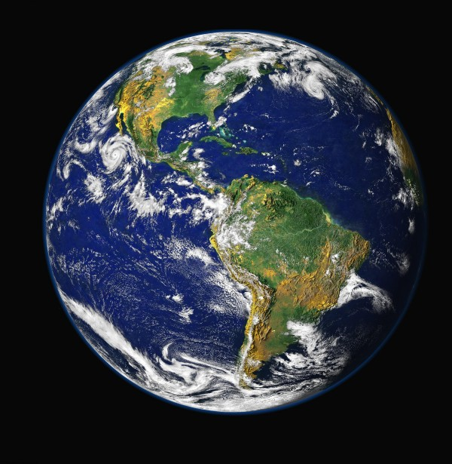

Public Opinion and Global Security
Dr Colin Irwin
University of Liverpool, UK
www.peacepolls.org

Slide 2
Public Opinion and War
WW2 Invasion of Italy 1943 – Only resistance German Army (Gallup)
Chechnya 1990s, Georgia 2008, Crimea / Donbas 2014, Syria 2015
Ukraine February 24th 2022
‘If the invasion of Russia takes place, how confident are you that Ukraine will be able to repel the attack?’ (Rating Group)
 | 27-28 January 2022 | 12-13 February 2022 | 16-17 February 2022
Not sure | 15 | 17 | 13
Rather unsure | 23 | 19 | 19
Difficult to answer | 6 | 7 | 4
Rather certain | 34 | 32 | 36
Absolutely certain | 22 | 26 | 28

Slide 3
Public Opinion, Peace and Security
Gallup franchise, Governments, NDI, IRI, NGOs,
Did Russian inteligence/ Vladimear Pution ignor public opinion research?
Merchant, T. and Lee, M., (2022) American spy agencies review their misses on Ukraine, Russia, AP News
WW3?, Climate Change, Pandemics, Food insecurity, Species extinction, UN Sustainable Development Goals (SDGs)
Guterres, A., (2022) UN chief appeals for cooperation to address ‘world in peril’, UN General Assembly,14 September.
Irwin, C., Gilani, I., Gilani, M. B., (2020) A critical review of the UN75 Global surveys presented to the 2020 UN General Assembly, WAPOR 73rd Annual Conference
UN Inovation Cell, Department of Political and Peacebuilding Affairs, (DPPA) and AI Digital Dialogues

Slide 4
UN AI Digital Dialogues and Remesh AI
Up to 1000 participants in a ‘chat’
Polling and open ended questions in ‘natural language’
Participants ‘vote’ on others answers ‘agree or disagree’ and/or which of two suggestions is better
Demographics / ‘onboarding’ questions provides real time analysis of agreement and disagreement between ‘sides’ and other demographics
Combine and merge data sets, increased capacity, quota samples, branch questions down ‘yes’ and ‘no’ responses etc. etc.
2020/2022 – Yemen, Libya, Bolivia, Haiti, Iraq

Slide 5
Peace Polls Best Practice
1. All the parties to a conflict should draft and agree to all the questions.
This was done to make sure all possible options for peace were covered in the questionnaire, to eliminate bias in the questions, and to prevent the parties to the conflict saying ‘this was the wrong question’ when they did not like the results.
2. All the communities and peoples to the conflict should be asked all the questions.
In addition to agreeing to the questions the parties to the conflict should also agree the methodology so they can not dismiss the results as a bad or biased sample.
3. All the results should be made public.
If all the results are not published the parties to the conflict can ignore the results and / or ‘cherry pick’ them and leak the results they like best to their publics. Public dissemination also extends ‘ownership’ of the peace process to all those involved in the conflict.

Slide 6
IGO Peace Making in Practice
Yemen - Dialogues across all of Yemen – Mokha polls and other polls – No rule 1 and 3
Libya – Facebook / TV real time publication – No rule 1
Bolivia – No rule 2 and 3, one side on rule 1 but Daniel Morales got same insights on poll and dialogue
Haiti – Ran in local French Creole
Iraq – Munqith Dagher IIACSS helped but too rushed
Israel / Palestine – Israeli PMs Office concerned about Israel / Arab relations – No peace poll or AI Dialogue
Lebanon –Arab Barometer poll after dock explosion but no AI Dalogue
Sudan – Could have run Facebook / TV diague before coup
Moldova / Transnistria – IPI Vienna and OSCE 2012, 2015, 2019, 2022
Ukraine – Could have followed up from Moldova / Transnistria
Macedonia, Kosovo – Stoped war but no progress on Mitrovica after 17 years

Slide 7
Limits of International Peace Making
1945 UN Charter “The Purpose of the United Nations
(1) To maintain international peace and security, and to that end: to take effective collective measures for the prevention and removal of threats to the peace… etc.”
All UN Missions subject to Security Council vote and Permanent Five veto
Similarly all OSCE member states have a veto
All IGO activities subject to self censorship in context of vetos
‘Expressed function’ of IGOs to uphold UN Charter and make peace
‘Latent function’of IGOs to maintain the life of the IGO
IGOs find it almost impossible to follow peace poll rules 1, 2 and 3 at all times

Slide 8
Public Opinion Peace Poll Solutions
Presently Peace polls are ad hoc with NGOs - Joseph Rowntree Charitable Trust, George Soros Foundation, Norwegian and German Government Foundations, Interpeace etc.
Agency to match up peace poll requirement (eg Moldova and Ukraine in 2012/14) with willing funder
Global Poll to track and identify potential conflicts ‘in the making’
Global Poll to track and monitor all UN Sustainable Development Goals (SDGs)

