Slide 1
AI and Peace Polls
Dr Colin Irwin
University of Liverpool

Slide 2
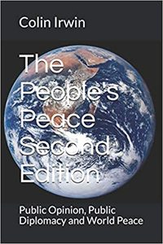
‘Pencil and Paper’ Peace Polls
Negotiator’s scale developed for Northern Ireland peace process in 1990s
Essential: You believe this option is an extremely necessary part of a solution to the Transdniestria issue and should be fully implemented
Desirable: This option is not what you would consider to be ‘Essential’, but you think this option, or something very similar to it, is a good idea and should be put into practice.
Acceptable: This option is not what you would consider to be ‘Desirable’, if you were given a choice, but you could certainly ‘live with it’.
Tolerable: This option is not what you want. But, as part of a solution to the Transdniestria issue, you would be willing to put up with it for peace.
Unacceptable: This option is totally unacceptable under any circumstances. You would not accept it, even as part of a peace agreement to solve the Transdniestria issue.
www.peacepolls.org

Slide 3
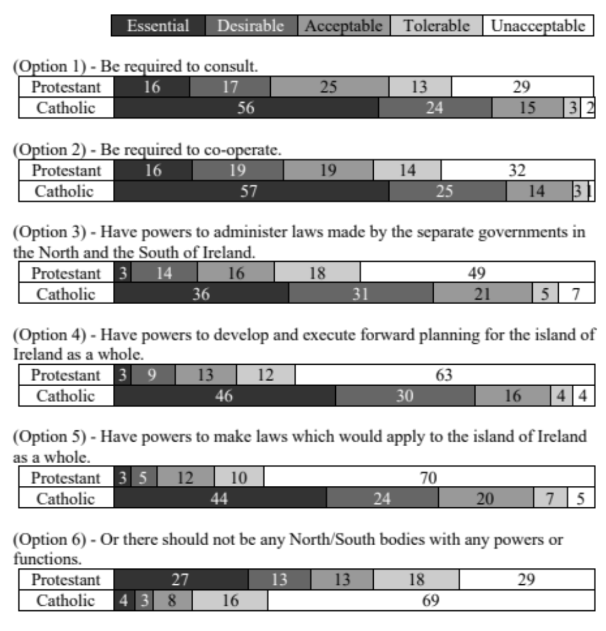
Protestant and Catholic support for the six options:
‘On matters of mutual interest North/South bodies should’

Slide 4
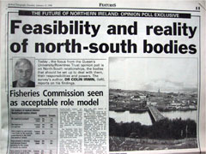
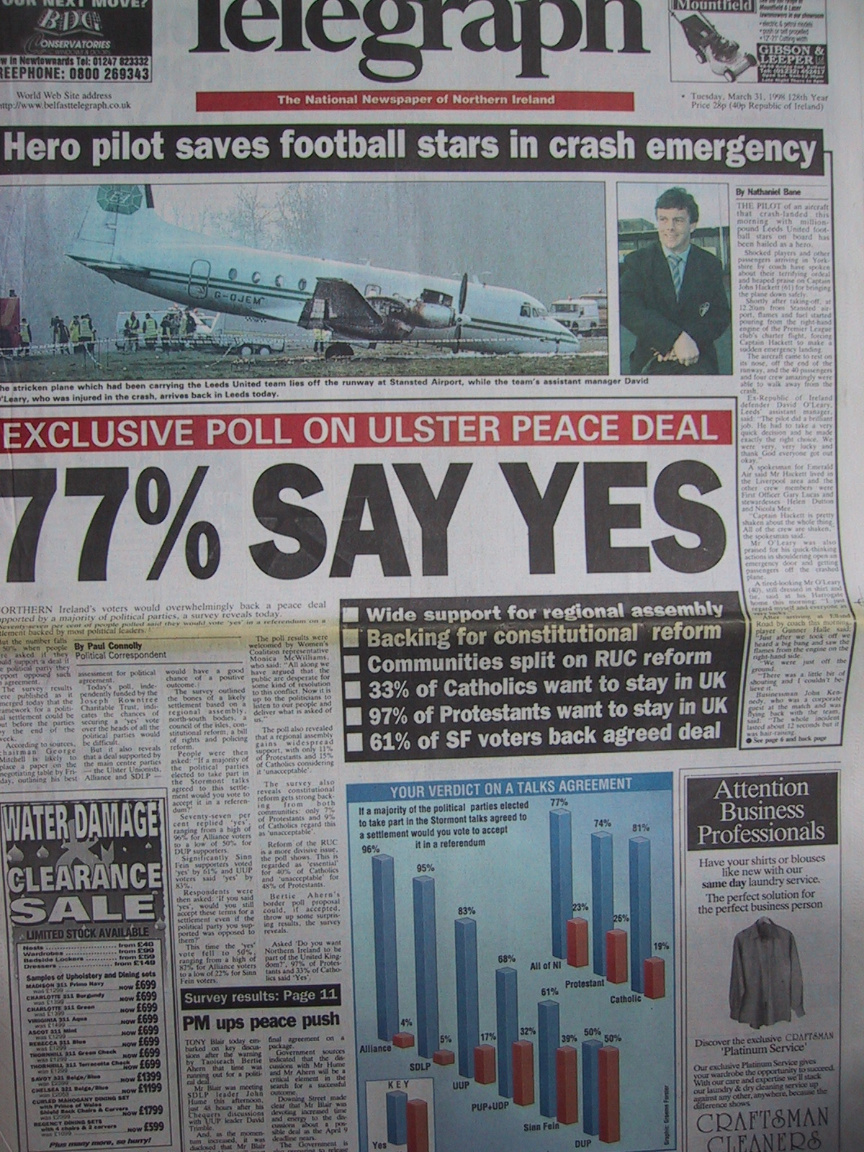
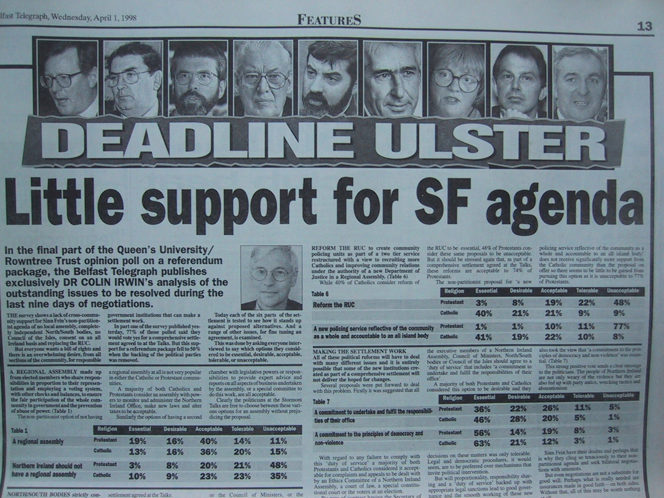
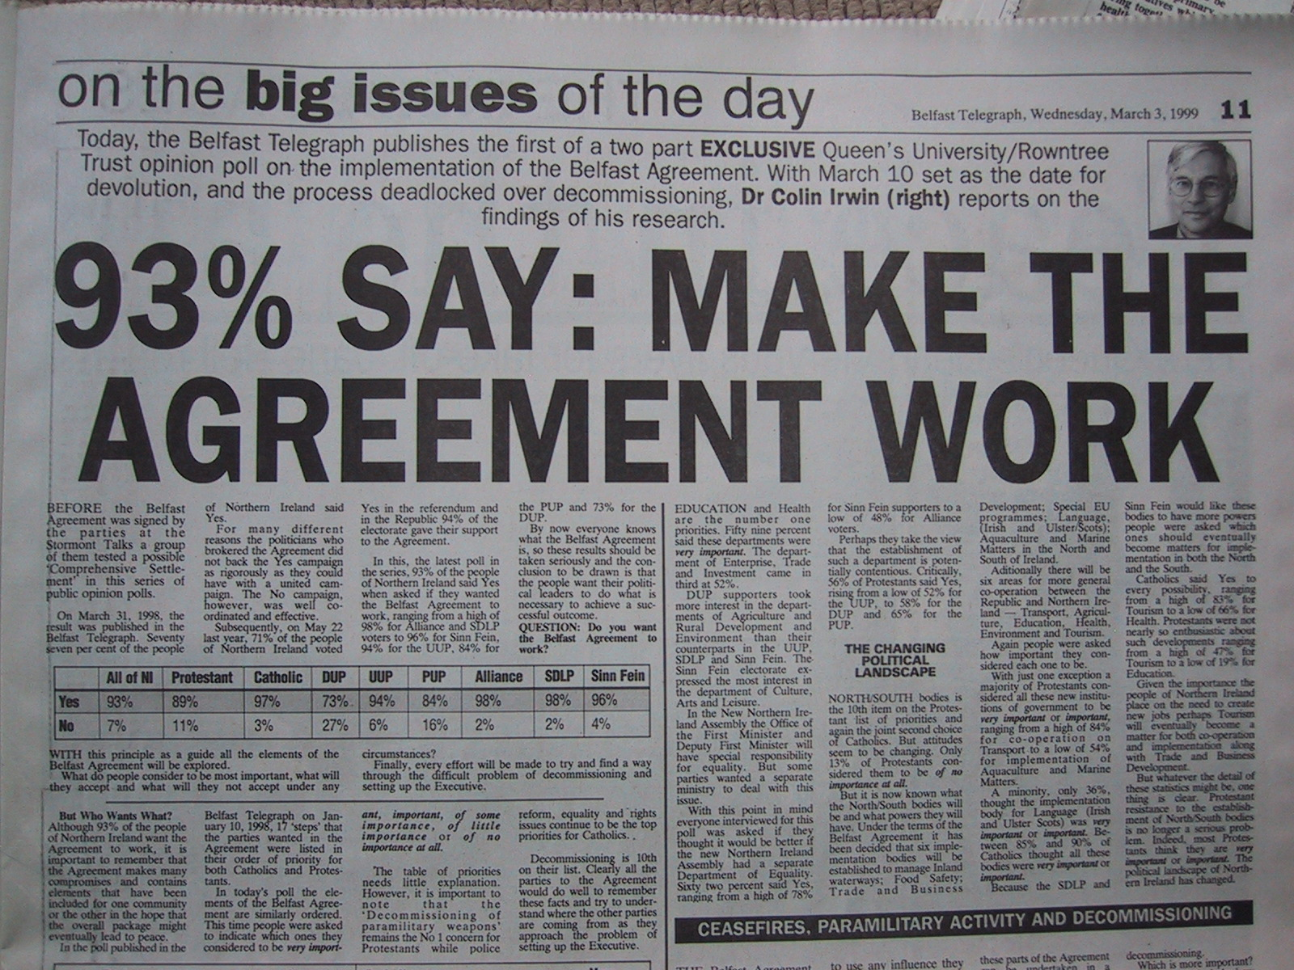
Public Diplomacy Belfast Telegraph

Slide 5
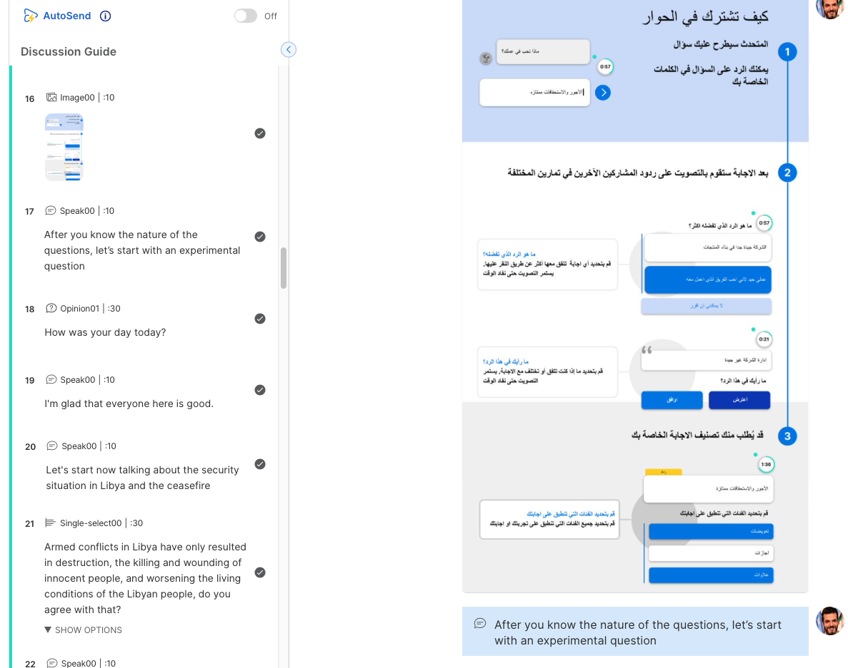
RemeshAI live Digital Dialogue

Slide 6
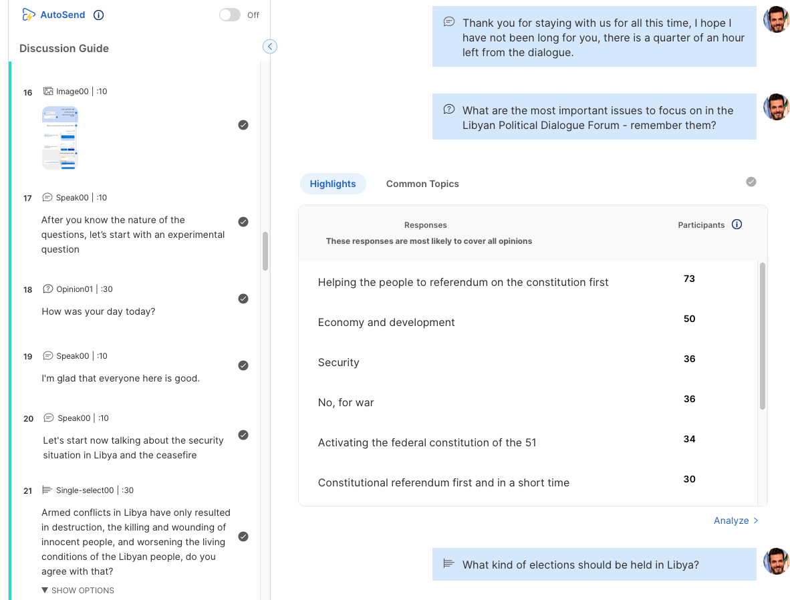
RemeshAI live Digital Dialogue

Slide 7
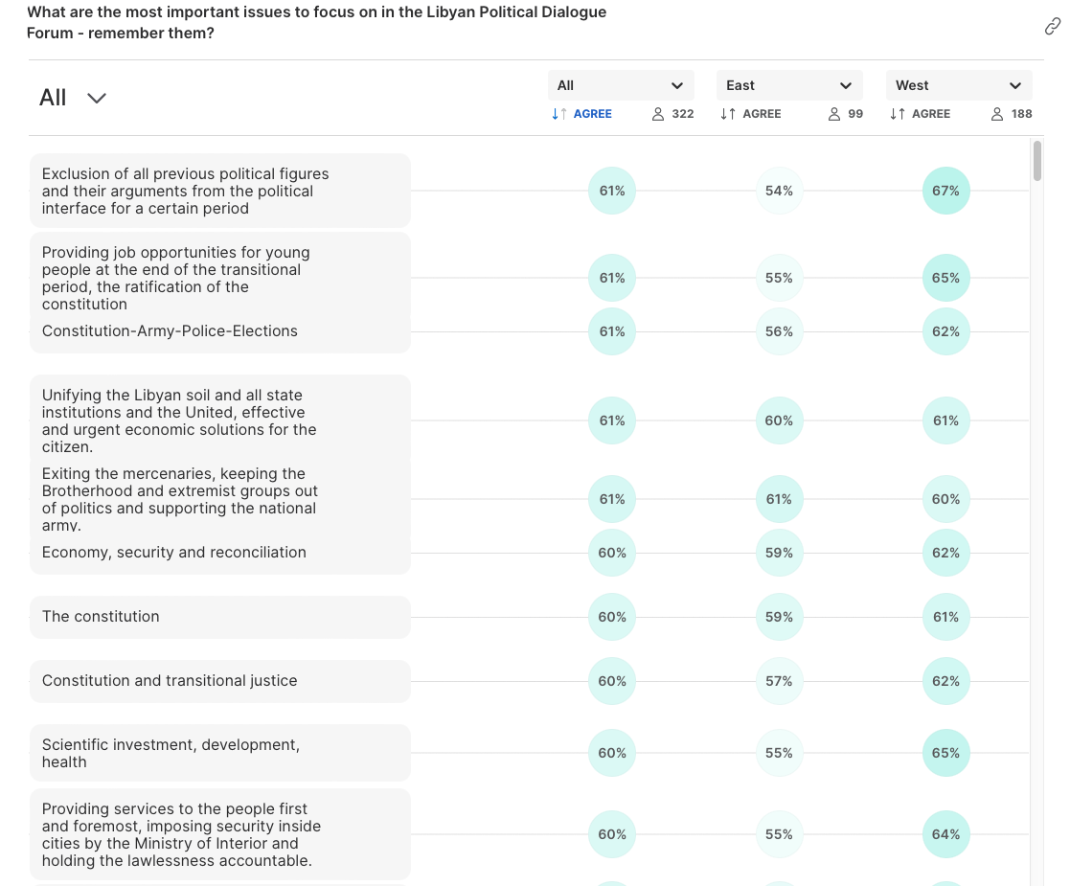
RemeshAI live Digital Dialogue

Slide 8
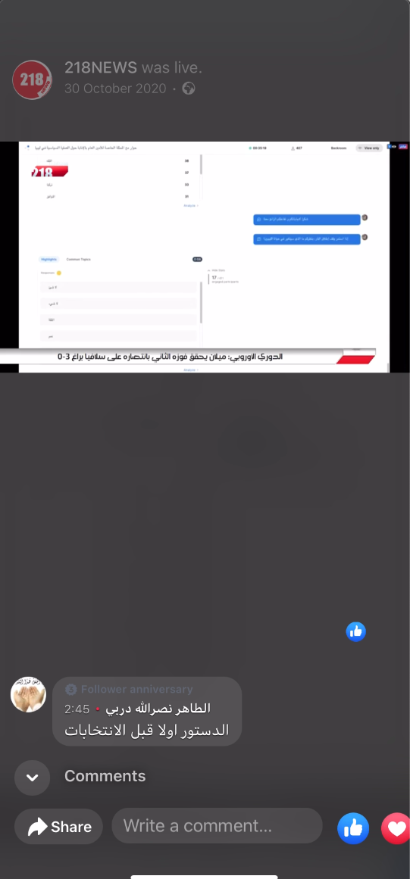
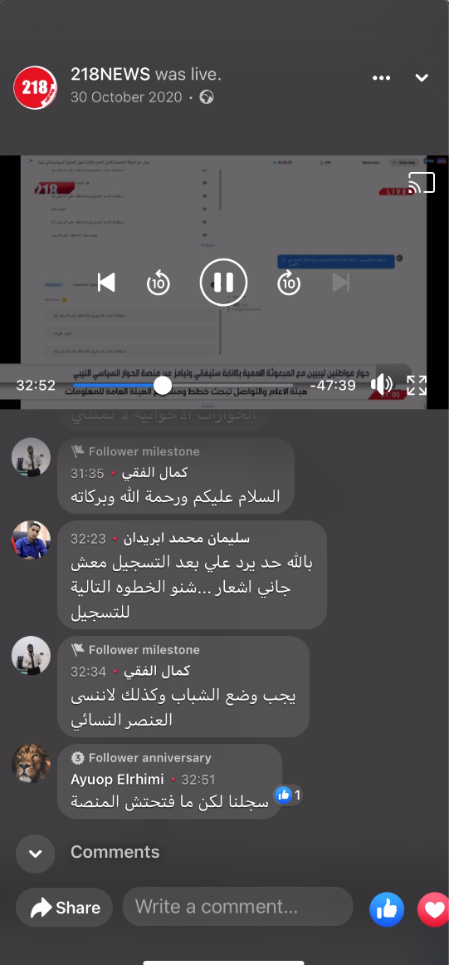
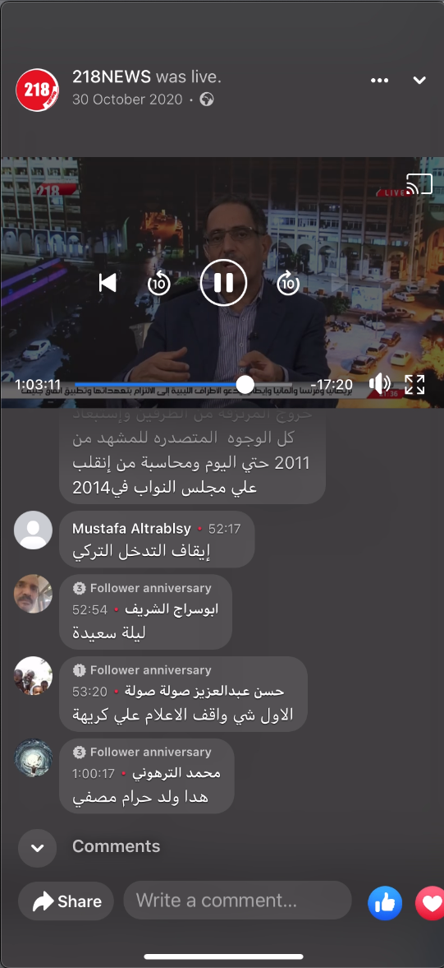
1.2 M Libyans followed this AI Dialogue on Facebook and TV

Slide 9
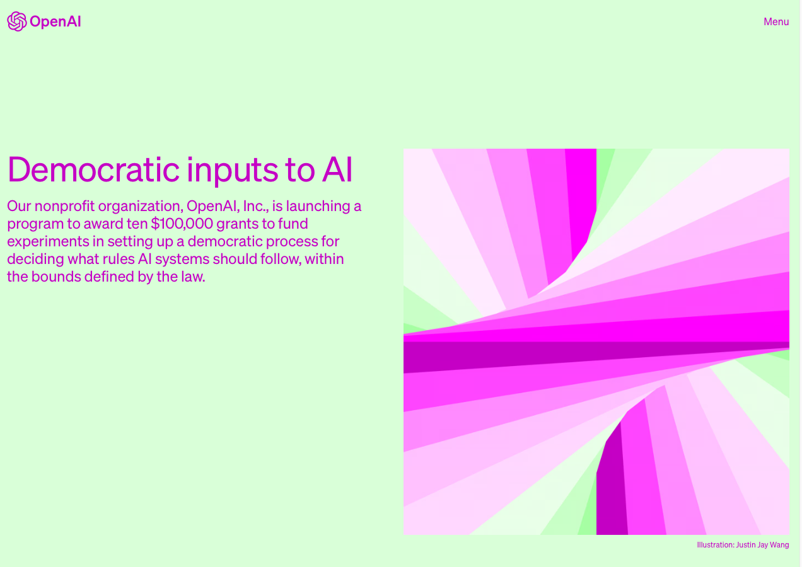
OpenAI

Slide 10
One of Ten Projects:
Collective dialogues for democratic input
Andrew Konya – RemeshAI
Colin Irwin – University of Liverpool
Lisa Schirch – University of Notre Dame
Aviv Ovadya – newDemocracy and Harvard

Slide 11
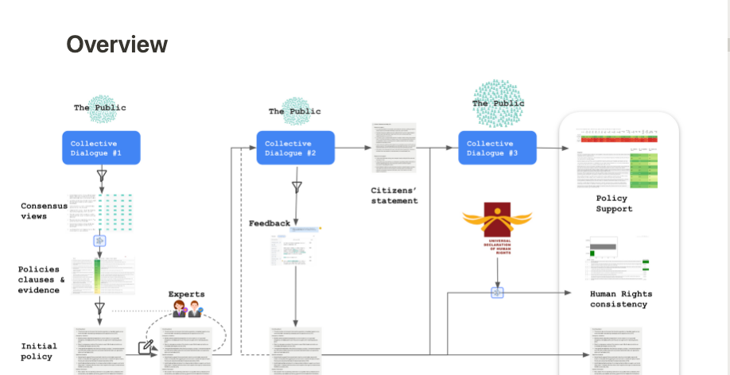

Slide 12
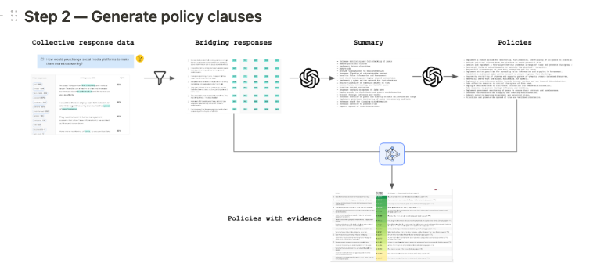

Slide 13
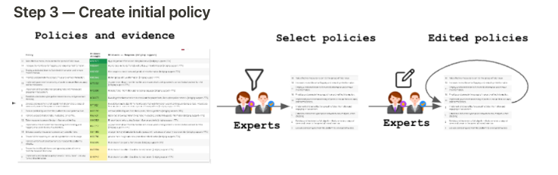

Slide 14
Utility of GPT-4
We used GPT-4 across multiple steps of our process to significantly accelerate laborious steps. Specifically, we used it to:
Summarize a set of natural language responses to a collective dialogue prompt
Generate policy clauses based on consensus viewpoints on an issue
Select natural language responses which best justify each policy clause
Evaluate the degree of entailment between a natural language response and a policy clause
Evaluate the consistency between a policy clause and a given human right or value

Slide 15

Corrected bias of Prolific sample

Slide 16
Policy v0.5
Overall guideline
This policy is a dynamic framework that should be expanded on and updated regularly as new issues arise, better understanding is developed, and AI's capabilities evolve. [74%]
Emergency situations
Quickly assess potential emergencies: In unclear situations involving potential emergencies, immediately ask the user if they are in an urgent and life-threatening situation. [67%]
Direct to emergency services: If the situation is urgent & life-threatening, help the user immediately call emergency services. [79%]
Time-sensitive treatment: After directing to emergency services, if time-sensitive treatment (e.g. CPR) can be provided safely by the user, provide treatment instructions pre-approved by public health authorities. [65%]
Sensitive situations
Mental health support: During mental health crises like suicidal ideation, respond with kindness and empathy while suggesting the user reach out to a counselor, therapist, or helpline. Provide up-to-date contact information for relevant crisis hotlines. [76%]
Avoid implying fatal outcomes: Do not diagnose fatal conditions or suggest a user may be dying, except in emergency situations where a user is urged to call emergency services because their life may be at risk. [72%]
Medical information
Not a doctor: The AI should always clarify that it's not a qualified medical professional, that it can sometimes make mistakes, and that any medical information it gives should not replace a consultation with a healthcare professional. [81%]
Share scientific knowledge: For general medical inquiries, do not provide a diagnosis or treatment advice, but offer a diverse range of relevant information based on scientific research from trusted sources, with links to those sources. [63%]
Prioritize trustworthy sources: Prioritize medical sources in the following order, starting with the most trustworthy: 1) medical society guidelines, 2) meta-analyses, 3) single randomized control studies, 4) observational studies, 5) doctor's opinions. [64%]
Basic health
Advocate for a healthy lifestyle: Offer general advice from trustworthy medical sources on maintaining a healthy lifestyle, including diet, exercise, stress management, and sleep hygiene. Suggest contacting professionals for personalized advice. [80%]
Assist with minor ailments: Offer basic first aid suggestions based on trustworthy medical sources for minor injuries and symptoms that are neither urgent nor life-threatening. [75%] </aside>

Slide 17
The PSR Palestine-Israeli Pulse, settlement package tested in June-July 2017
1. (In Israel) Mutual recognition of Palestine and Israel as the homelands of their respective peoples. The agreement will mark the end of conflict, the Palestinian state will fight terror against Israelis, and no further claims will be made by either side.
1. (In Palestine) Mutual recognition of Palestine and Israel as the homelands of their respective peoples. The agreement will mark the end of conflict, Israel will fight terror against Palestinians, and no further claims will be made by either side.
2. The independent Palestinian state which will be established in the West Bank and the Gaza Strip will be demilitarized (no heavy weaponry).
3. A multinational force will be established and deployed in the Palestinian state to ensure the security and safety of both sides.
4. The Palestinian state will have full sovereignty over its air space, its land, and its water resources, but Israel will maintain two early warning stations in the West Bank for 15 years.
5. The Palestinian state will be established in the entirety of West Bank and the Gaza strip, except for several blocks of settlement which will be annexed to Israel in a territorial exchange. Israel will evacuate all other settlements.
6. The territories Palestinians will receive in exchange will be similar to the size of the settlement blocs that will be annexed to Israel.
7. West Jerusalem will be the capital of Israel and East Jerusalem the capital of the Palestinian state.
8. In the Old City of Jerusalem, the Jewish quarter and the Wailing Wall will come under Israeli sovereignty and the Muslim and Christian quarters and Temple Mount will come under Palestinian sovereignty.
9. Palestinian refugees will have the right of return to their homeland whereby the Palestinian state will settle all refugees wishing to live in it. Israel will allow the return of about 100,000 Palestinians as part of a of family unification program. All other refugees will be compensated.
10. And now after we went over the main proposed terms of the two-state solution of the Israeli Palestinian permanent settlement (demilitarization of the Palestinian state, equal territorial exchange, the family unification in Israel of 100,000 Palestinian refugees, East Jerusalem the capital of Palestine and West Jerusalem the capital of Israel, and the end of the conflict, please tell me the extent to which you support or oppose such a permanent settlement in general as one combined package?

