Slide 1
CYPRUS LESSONS
How to melt a frozen conflict
North and South Cyprus,
Northern Ireland, Israel and Palestine,
North and South Korea
Colin Irwin
University of Liverpool www.peacepolls.org
WAPOR Marrakech June 27-30, 2018

Slide 2
Table 1.
Protestant and Catholic support for a Northern Ireland settlement and how they would vote in a referendum with and without the support of their political party in March 1998.
Package item (Per cent Essential + Desirable + Acceptable + Tolerable) | Protestant | Catholic
A Regional Assembly | 89 | 85
North/South bodies | 60 | 92
Council of the Isles | 83 | 70
Constitutional reform | 93 | 91
A Bill of Rights | 91 | 97
Reform of the RUC | 52 | 91
Vote ‘Yes’ with political party support for the agreement | 74 | 81
Still vote ‘Yes’ but without political party support for the agreement | 46 | 53

Slide 3
Table 2.
Support for Clinton’s Permanent Settlement Framework in December/January 2004/5.
Package item (Per cent support) | Israel | Palestine
Borders and Territorial Exchange | 55 | 63
Refugees | 44 | 46
Jerusalem | 39 | 44
Demilitarized Palestinian State | 68 | 27
Security Arrangements | 61 | 53
End of Conflict | 76 | 69
Overall Package | 64 | 54

Slide 4
Table 3 and 4.
If we assume a scenario where the 2 leaders agree on a solution and a referendum is held, how would you be likely to vote, would you vote YES or would you vote NO?
GC - All | Dec 16 SEED | Dec 16 Percent Pre Switzerland | Feb 17 Percent Post Switzerland | Feb 17 Percent Post Switzerland | March 17 Percent
Yes | 15+23 | 28 | 25 | 28 | 26
No | 32+12 | 26 | 29 | 30 | 29
Not decided/ it depends/DK/NA | 18 | 46 | 45 | 42 | 45
TC - All | Dec 16 SEED | Dec 16 Percent Pre Switzerland | Dec 16 Percent Pre Switzerland | Feb 17 Percent Post Switzerland | March 17 Percent
Yes | 23+21 | 40 | 44 | 46 | 49
No | 17+16 | 36 | 34 | 37 | 39
Not decided/ it depends/DK/NA | 24 | 24 | 22 | 17 | 12

Slide 5
Cyprus Joint Declaration 11 February 2014 - Clause 7
‘The sides will seek to create a positive atmosphere to ensure the talks succeed. They commit to avoiding blame games or other negative public comments on the negotiations. They also commit to efforts to implement confidence building measures that will provide a dynamic impetus to the prospect for a united Cyprus.’

Slide 6
Table 5.
The importance of CBMs March 2017
Do you expect the two sides to implement many of these CBMs?
 | Yes | No | D.K.
GC | 27% | 63% | 10%
TC | 28% | 71% | 1%
Would you like to see many of these CBMs implemented by the two sides?
 | Yes | No | D.K.
GC | 83% | 15% | 2%
TC | 86% | 14% | -
If the two sides implement these CBMs do you think that will improve the chances of reaching a final agreement on the future of Cyprus?
 | Yes | No | D.K.
GC | 69% | 26% | 5%
TC | 65% | 34% | 1%

Slide 7
Table 6A. Top Ten (Essential + Desirable) CBMs for TCs with results for GCs
TC Top Ten CBMs |  | Essential | Desirable | Acceptable | Tolerable | Unacceptable | D.K.
1. Coordinate and finance the repair and maintenance of cemeteries and graves in the North and South. | TC | 46% | 32% | 17% | 4% | 1% | 1%
 | GC | 37% | 23% | 26% | 3% | 10% | 2%
2. Arrange meetings between North and South fire brigades to agree joint procedures for dealing with catastrophic fires. | TC | 49% | 28% | 17% | 3% | 2% | 1%
 | GC | 48% | 14% | 23% | 5% | 9% | 1%
3. Facilitate the purchase of car insurance to cover both sides of the island at the same rates. | TC | 47% | 29% | 18% | 3% | 2% | 1%
 | GC | 29% | 15% | 25% | 8% | 20% | 3%
4. Being able to use your mobile phones on both sides of the island without limitation on where you are. | TC | 31% | 44% | 19% | 3% | 3% | 1%
 | GC | 43% | 12% | 23% | 5% | 12% | 6%
5. Ensure a common time zone across the whole of Cyprus | TC | 37% | 36% | 19% | 3% | 4% | 1%
 | GC | 57% | 14% | 18% | 4% | 6% | 2%
6. Remove the requirement for the Enosis plebiscite to be commemorated in GC schools. | TC | 44% | 21% | 17% | 9% | 9% | 1%
 | GC | 15% | 8% | 15% | 6% | 47% | 9%
7. Allow all persons born or not born in Northern Cyprus with a right to vote in a referendum have access to the South. | TC | 36% | 29% | 19% | 6% | 7% | 2%
 | GC | 16% | 10% | 15% | 7% | 46% | 6%
8. Complete and open the new crossing in Famagusta at Dherynia without any further delay. | TC | 32% | 32% | 20% | 7% | 9% | -
 | GC | 27% | 17% | 25% | 9% | 20% | 3%
9. Complete the North/South electricity interconnector without further delay. | TC | 26% | 37% | 25% | 5% | - | -
 | GC | 21% | 14% | 22% | 9% | 29% | 4%
10. Promote North/South trade by extending the scope of Green Line regulations | TC | 25% | 37% | 30% | 3% | 4% | 1%
 | GC | 17% | 12% | 20% | 7% | 39% | 4%

Slide 8
Table 6B. Top Ten (Essential + Desirable) CBMs for GCs with results for TCs
GC Top Ten CBMs |  | Essential | Desirable | Acceptable | Tolerable | Unacceptable | D.K.
1. Turn off the lights of the Turkish Cypriot flag to show TC support for the negotiations | GC | 68% | 13% | 11% | 2% | 5% | 1%
 | TC | 4% | 5% | 6% | 10% | 74% | 1%
2. Ensure a common time zone across the whole of Cyprus. | GC | 57% | 14% | 18% | 4% | 6% | 2%
 | TC | 37% | 36% | 19% | 3% | 4% | 1%
3. Allow owners of property in Varosha to visit their properties. | GC | 47% | 22% | 21% | 3% | 7% | 1%
 | TC | 22% | 29% | 27% | 10% | 11% | 1%
4. Return Icons to their rightful owners. | GC | 53% | 15% | 19% | 2% | 9% | 2%
 | TC | 19% | 29% | 28% | 13% | 9% | 1%
5. Allow the Greek Church in Famagusta to be opened for Easter services. | GC | 44% | 23% | 22% | 3% | 8% | 1%
 | TC | 10% | 24% | 33% | 13% | 19% | 2%
6. For example allow the vacated Archbishopric in Kyrenia to be restored and made available for religious festivals. | GC | 43% | 21% | 24% | 6% | 7% | 1%
 | TC | 12% | 20% | 31% | 16% | 20% | 1%
7. Arrange meetings between North and South fire brigades to agree joint procedures for dealing with catastrophic fires. | GC | 48% | 14% | 23% | 5% | 9% | 1%
 | TC | 49% | 28% | 17% | 3% | 2% | 1%
8. Make vacated military installations on religious and public property available to their owners. | GC | 40% | 21% | 26% | 3% | 6% | 5%
 | TC | 13% | 20% | 26% | 13% | 27% | 1%
9. Coordinate and finance the repair and maintenance of cemeteries and graves in the North and South. | GC | 37% | 23% | 26% | 3% | 10% | 2%
 | TC | 46% | 32% | 17% | 4% | 1% | 1%
10. Being able to use your mobile phones on both sides of the island without limitation on where you are. | GC | 43% | 12% | 23% | 5% | 12% | 6%
 | TC | 31% | 44% | 19% | 3% | 3% | 1%

Slide 9
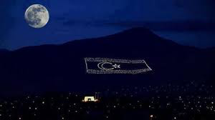
Turkish Cypriot flag at night viewed from Greek Cypriot Nicosia

Slide 10
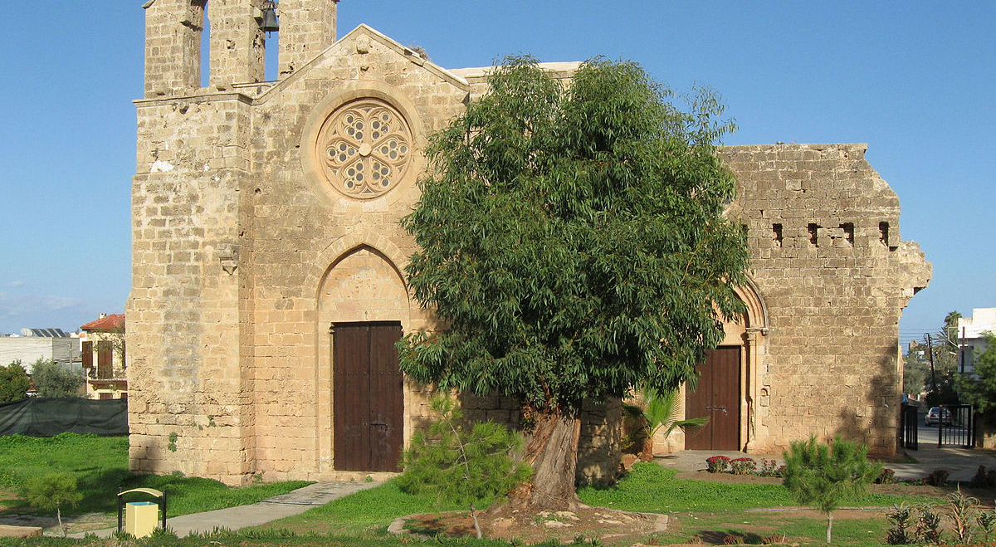
Greek Orthodox Nestorian Church ‘St George the Exiler’ in Famagusta

Slide 11
Table 7
Israeli and Palestinian support for nine-point agreement package in June/July 2017
Package item (Per cent support | Israel | Palestine
1. Mutual recognition | 66 | 49
2. Demilitarized Palestinian State | 23 | 60
3. Multilateral security force in Palestine | 40 | 50
4. Palestinian sovereignty and Israel security | 33 | 39
5. Settlement blocs | 34 | 40
6. Territorial exchange | 31 | 41
7. East and West Jerusalem as capitals | 29 | 22
8. Old City of Jerusalem religious sites | 28 | 27
9. Palestinian refugees | 55 | 29
10. Package as a whole | 43 | 41

Slide 12
Table 8.
Per cent of Israeli ‘no’ voters who switched to ‘yes’ for symbolic or substantive CBMs or incentives offered in December 2016 and June/July 2017
Symbolic or substantive CBM or incentive | %
Jews who left their homes and property in the Arab countries following the 1948 War will be compensated for the lost assets left behind (2016) | 40
Palestinians agree to change school textbooks to remove incitement to hatred against Jews (2017) | 35
Palestinians acknowledge the historic and religious links between Jews and historic Palestine (2016) | 34
Recognition of Jewish holy sites in Judea and Samaria with Jewish rights to access and security guarantees (2017) | 33
Palestinian recognition of Israel as a Jewish state (2016) | 32
Agreement is part of a larger peace with all Arab states (2016) | 30
Allow Israeli air force full access to Palestinian airspace (2017) | 30
Prime Minister Netanyahu declared his support for the package (2017) | 29
Joint Israeli-Palestinian economic ventures (2017) | 25
Free movement for both sides throughout the other side’s state (2016) | 24
Israelis are guaranteed free access to holy sites in Jerusalem and other places (2016) | 23
Settlers allowed to stay, to keep Israeli citizenship and their safety guaranteed by the Palestinian state (2016) | 21
Holy sites to be placed under the custody of a multi-national committee from Israel, Palestine, Saudi Arabia, Jordan, and the US (2016) | 10

Slide 13
Table 9.
Per cent of Palestinian ‘no’ voters who switched to ‘yes’ for symbolic or substantive CBMs or incentives offered in December 2016 and June/July 2017
Symbolic or substantive CBM or incentive | %
The release of all Palestinian prisoners (2017) | 56
Palestinian labourers can freely work in Israel after the establishment of the Palestinian state (2016) | 44
Israel acknowledges the historic and religious links between Palestinians and historic Palestine (2016) | 44
Refugees are compensated and provided with homes and land in Palestinian state (2016) | 42
Free movement for both sides throughout the other side’s state was assured (2016) | 40
Peace agreement is based on a long term hudna between the two sides (2016) | 34
Marwan Barghouti declares his support for the package (2017) | 34
Israelis agree to change school textbooks to remove incitement to hatred against Palestinians (2017) | 32
Israel apologizes for the suffering it has inflicted on the Palestinian refugees (2017) | 32
Israel agrees to accept the Arab peace initiative and all Arab countries support peace treaty (2016) | 28
Joint Palestinian-Israeli economic ventures (2017) | 27
Holy sites to be placed under the custody of a multi-national committee from Israel, Palestine, Saudi Arabia, Jordan, and the US (2016) | 19

Slide 14
Statement sent to the two leaders by the Greek Turkish Forum 28 February 2018
The successful completion of the negotiations and a sustainable peace require mutual trust, mutual respect, and a spirit of cooperation. To this end, GTF brings to the attention of the two leaders their commitment to implement mutually agreed confidence-building measures. Given the importance of the subject, GTF also recommends a non-exhaustive list of proposals for further measures. These include:
Ensure a common time zone across the whole of Cyprus
Coordinate and finance the repair and maintenance of cemeteries
Arrange meetings between the two fire brigades to agree on a joint procedure for dealing with catastrophic fires.
Return icons to their rightful owners.
Facilitate purchase of car insurance to cover all the island at the same rates.
Facilitate use of mobile phones throughout the island without limitation on the geographical position of the caller.
Permission for respective religious buildings to be opened for services .e.g in Famagusta on Easter Sunday
Complete the opening up of the Derynia and Apliki crossing points.
Complete the electricity interconnector without further delay.
Kyrenia Archbishopric to be restored and opened for religious feasts.
Expand cooperation and exchanges between the two communities in the field of education is an urgent need and more regarding joint citizenship courses in the educational systems could be established as soon as possible.
Adopt Europa Nostra’s proposal to celebrate European Cultural heritage year 2018 in the only divided capital in the European Union, by opening passages in Victoria street and the market area, combined with an urgent programme of consolidation and conservation of architectural heritage in the Green line.

Slide 15
Proposed Confidence Building Measures (CBMs) for Korea Peace Process
“Recent sporting and cultural events have demonstrated the value of Confidence Building Measures in establishing better relationships between North and South Korea. We would like your opinion on a variety of additional CBMs that could now be implemented. “
Please indicate which CBMs you consider to be ‘Essential’, ‘Desirable’, ‘Acceptable’, ‘Tolerable’ or ‘Unacceptable’
Establish regular joint music concerts / festivals in North and South Korea 남북 공동음악회 또는 공동음악축제 정기적 개최
Replace the South/North Korean flags at the DMZ (Daeseong-dong in the South /Kijeong-dong in the North) with a Unified Korea Flag 대성동/기정동 마을 태극기/인공기 한반도기로 대체
Conduct a joint field investigation into the ecosystem in the DMZ DMZ 생태계 남북 공동연구 실시
Conduct a joint field investigation into the possible volcanic eruption at Mount Baekdu 백두산 분화 관련 남북 공동연구 실시
Conduct a joint field trip to Mount Baekdu between the representatives of the legislatures of the two Koreas 남북 의회대표단 백두산 공동 방문
Establish regular meetings between the highest authorities in North and South Korea 남북 정상 및 고위급 회담 정례화
Conduct SK governmental press briefings describing NK system/society in a positive manner 북한체제 및 사회 관련 긍정적 묘사 한국 정부 브리핑 실시
Report an article describing SK system/society in a positive manner on the first or second page of the Rodong Sinmun (NK’s official state newspaper) 북한 노동신문 1면 혹은 2면에 한국체제 및 사회 관련 긍정적 묘사 기사 게재
Express SK’s understanding of NK’s security concerns by SK 한국의 ‘북한 안보우려 이해’ 입장 표명
Express NK’s understanding of ROK-US alliance by NK 북한의 ‘한미동맹 이해’ 입장 표명
Proclaim a return to the spirit of The Joint Declaration on the Denuclearization of the Korean Peninsula (1992) by both Koreas 한반도 비핵화 공동선언 (1992) 정신 존중 선언 (남북 동시)
Proclaim a return to the spirit of The September 19 Joint Statement (2005) on Denuclearization by North Korea and non-aggression by the USA 9.19 공동성명 (2005) 정신 존중 선언 (북한 비핵화 및 미국의 대북 불가침)
Establish regular joint music concerts / festivals in North and South Korea 남북 공동음악회 또는 공동음악축제 정기적 개최

Slide 16
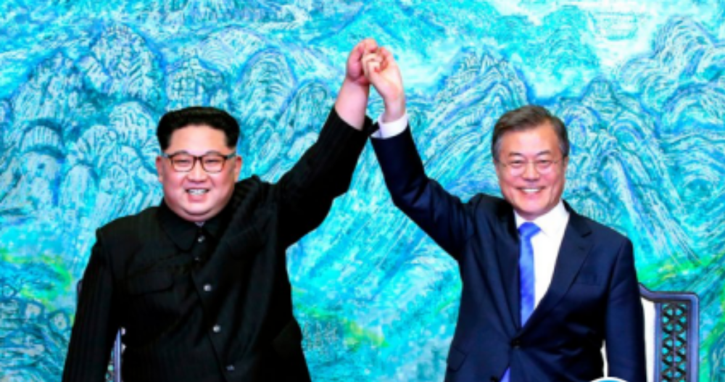
Kim and Moon, Korea Summit April 27 2018

Slide 17
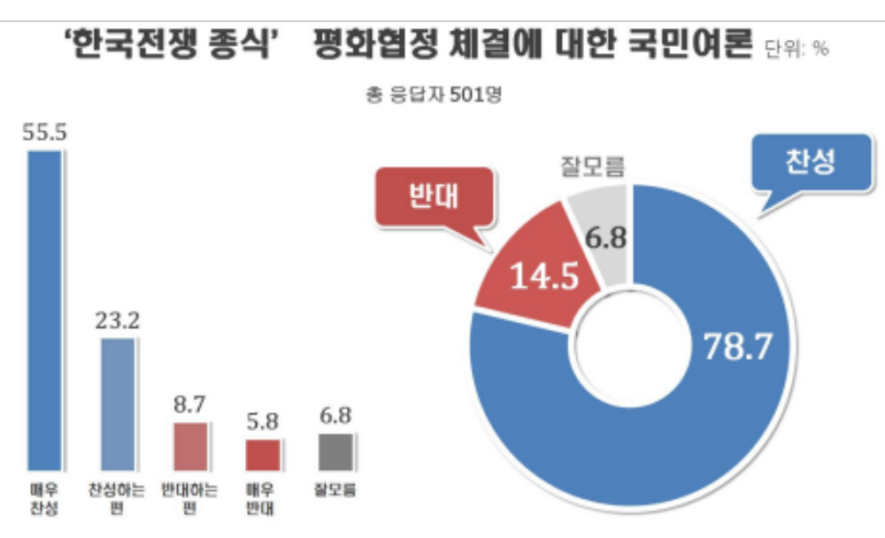
RealMeter 19 April 2018

Slide 18
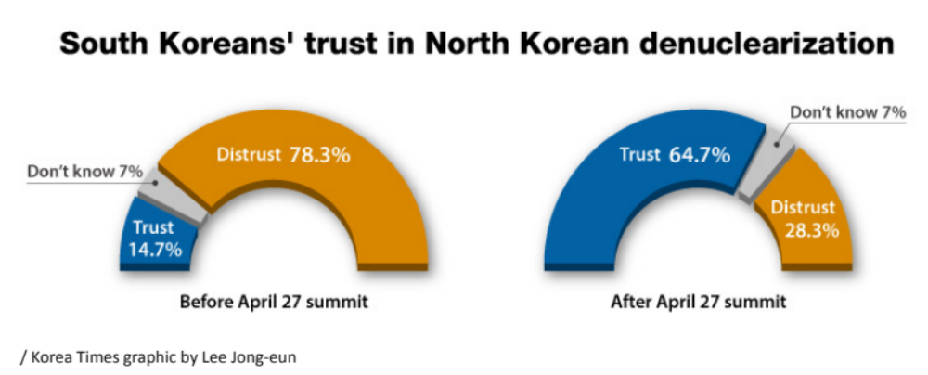
Before and After April 27 Summit

Slide 19
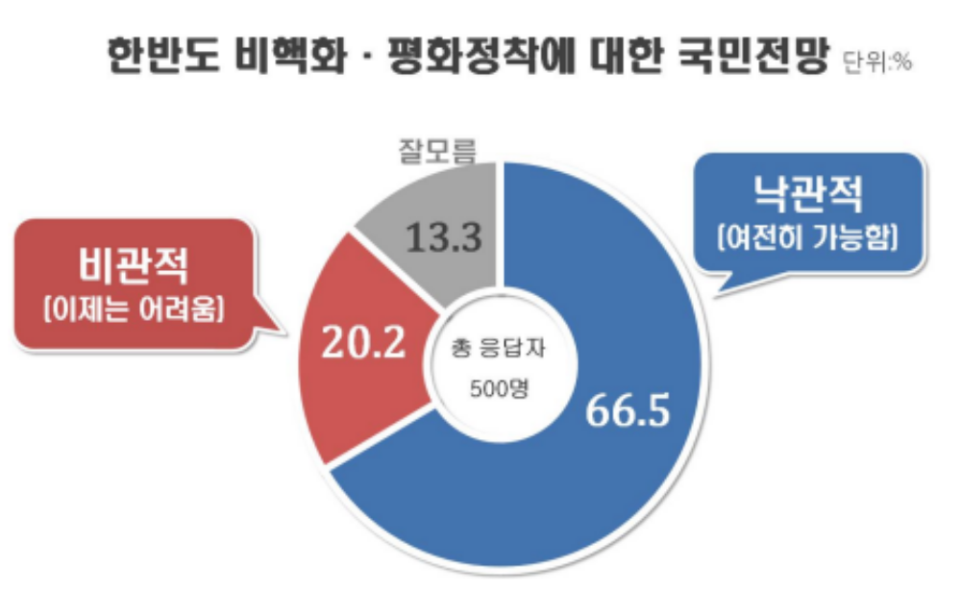
RealMeter 18 May 2018

Slide 20
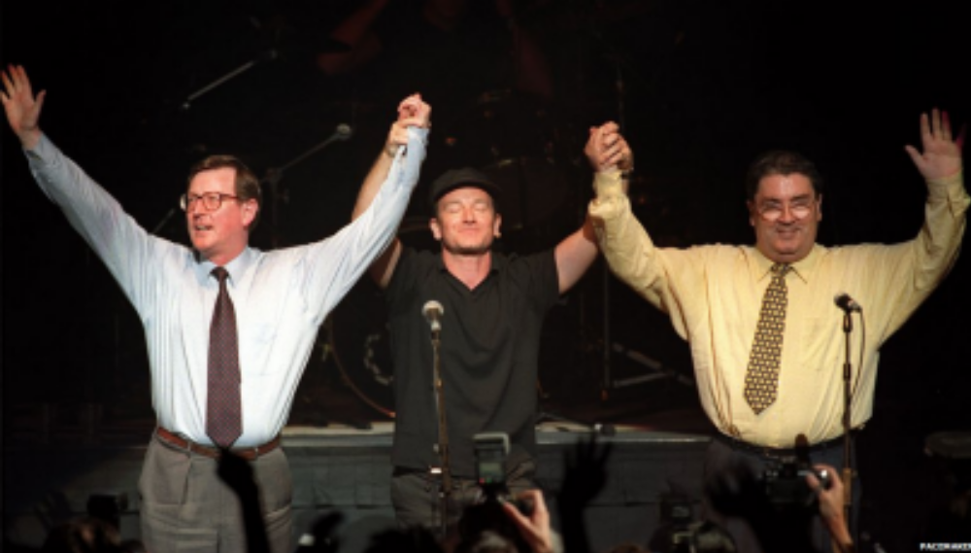
Trimble, Bono and Hume, May 19th 1998

Slide 21
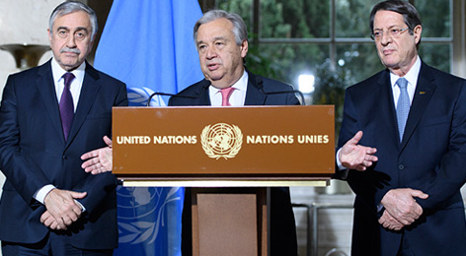
Akinci, UNSG and Anastasiades
Crans-Montana July 7th 2017 – www.peacepolls.org

