Slide 1
Pilot study for a
‘people’s peace process’ in syria
Colin Irwin
Department of Politics, University of Liverpool
World Association of Public Opinion Research
Regional Conference, 7-9 March 2014, Doha, Qatar.

Slide 2
Syria, War and ‘Peace Polls’
Peace Polls
Northern Ireland (1996 to 2003)
Macedonia (2002), Bosnia Herzegovina (2004), Kosovo & Serbia (2005), UK Muslims (2006), Kashmir (2008 to 2010), Sri-Lanka (2008 to 2010), Israel & Palestine(2008/9), Sudan (2009)
UN DPKO Review and Report 2013
Syria Peace Poll Workshop – 22 to 24 February 2014 (SOC & LACU)
Syria questionnaire field work – 24 April to 1 May 2014 (NPWJ & TDA)
Syria Pilot 1 – 15 May to 5 August 2014 (TDA)
Syria Pilot 2 – 10 October to 25 October 2014 (TDA)
Syria Conflict and Peace Initiatives
2011/12 - Civil unrest, insurgency and escalation
2012 - Geneva I
2014 - Geneva II
2015 - Cairo and Moscow ‘Talks’
Geneva III?

Slide 3
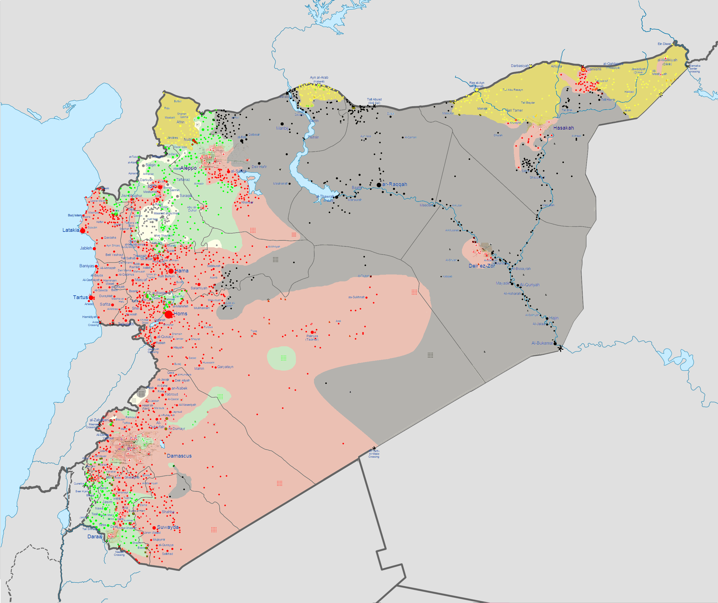
Map of Syria - Conflict

Slide 4
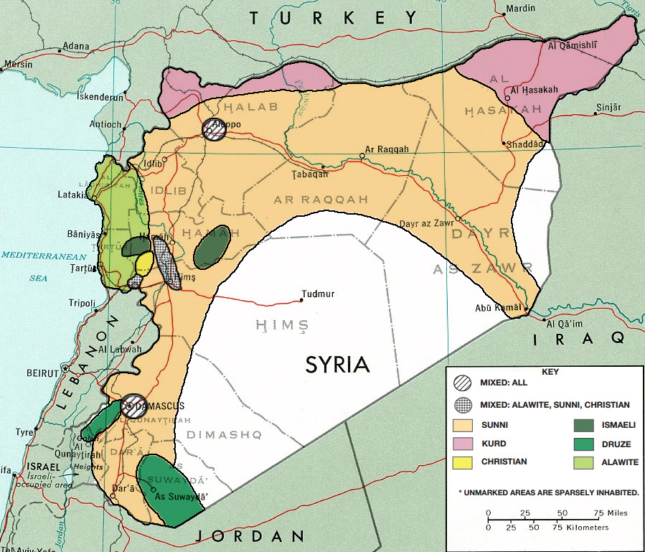
Map of Syria - Ethnic Groups

Slide 5
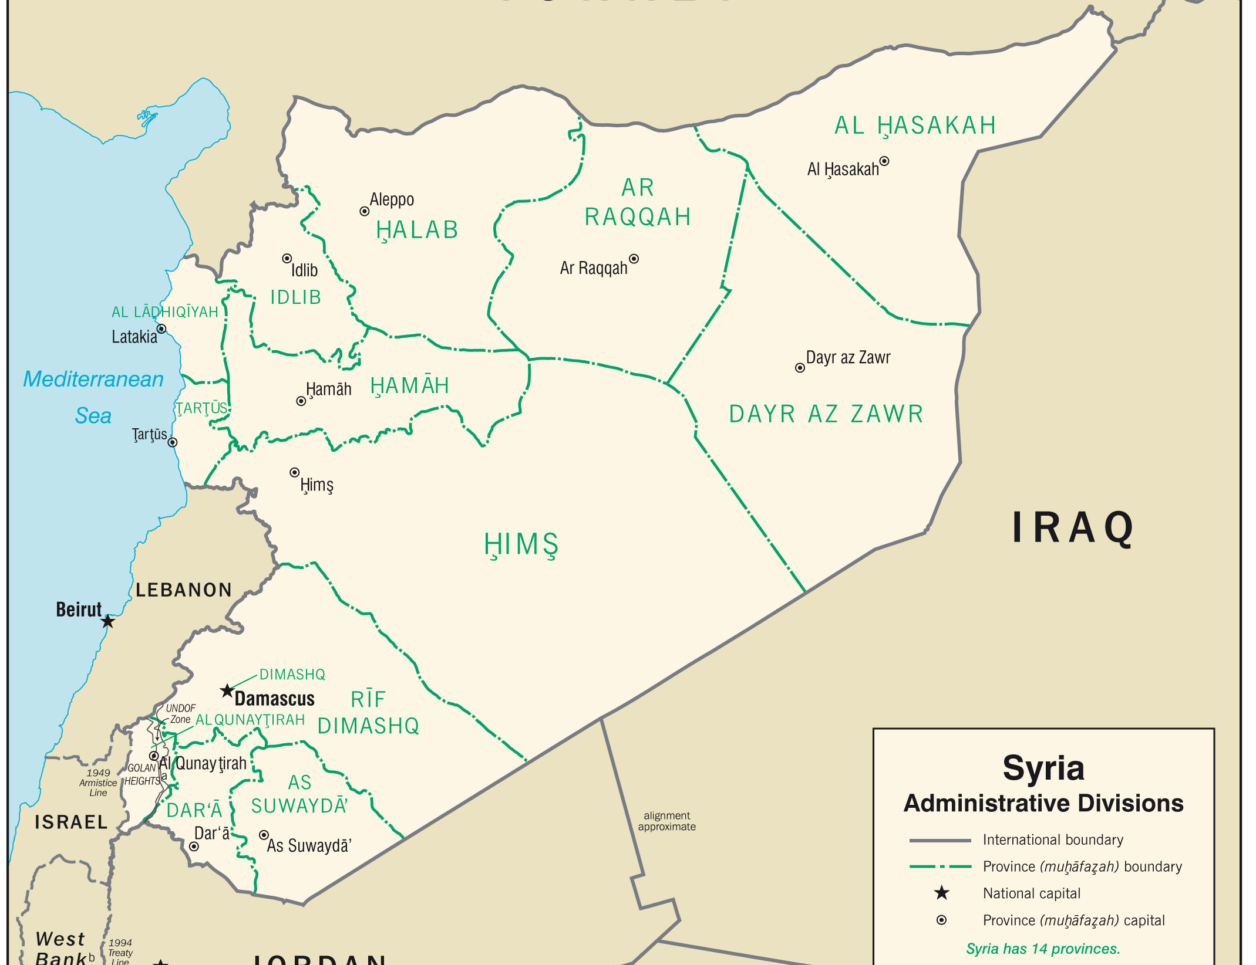
Map of Syria - 14 Governorates

Slide 6
Table 1. Pilot 1 Sample
Governorate and camps | n interview | n domicile
Damascus | - | 30
Aleppo | 261 | 377
Homs | 2 | 49
Hama | 27 | 64
Idlib | 181 | 216
Deir Ezzor | 345 | 352
Raqqa | - | 6
Hassakah | 67 | 64
Daraa | - | 189
Swaida | - | 2
Qunaitera | - | -
Latakia | - | 8
Tartus | - | -
Damascus countryside | 136 | 140
Zaatary Camp (Mokhayam) | 264 | 0
Turkish Camp (Mokhayyamat) | 215 | 0

Slide 7
Table 2. Pilot 1 Demographics
Demographic | n interview | Pilot sample per cent interview | Pre-war Syria per cent
Male | 1,090 | 72.7 | 52
Female | 405 | 27.0 | 48
Muslim | 365 | 24.3 | 90
Christian | 9 | 0.6 | 10
Muslim Sunni | 1,074 | 71.6 | 74
Muslim Alawite | 2 | 0.1 | 13
Muslim Shi’a | - | - | <3
Muslim Druze | 2 | 0.1 | <3
Muslim Ismaeli | 12 | 0.8 | <3
Arab | 1,400 | 93.4 | 90
Kurd | 59 | 3.9 | 9
Circassian | 1 | 0.1 | <1
Armenian | 1 | 0.1 | <1
Assyrian | 8 | 0.5 | <1
Other | 15 | 1.0 | -

Slide 8
Table 3. Pilot 2 Sample
Demographic | n interview | n domicile
Latakia (Alawite) | 33 | 33
Tartus (Alawite) | 15 | 15
Turkish Camp (Mokhayyamat) Kurd Refugees | 52 | Aleppo 52

Slide 9
Table 4. Open-ended Question 1: Every part of Syria is different so first of all can you please tell me what you think is the most serious problem that has to be dealt with in your country today? Write in……….
Rank | Syria Opposition Sample | n | Kurd Sample | n | Kurd Refugee Sample | n | Alawite Sample | n
1 | Syrian regime | 396 | The war | 18 | The war | 13 | The war | 18
2 | The war | 245 | Syrian regime | 6 | The conflict between the regime and the opposition | 8 | ISIS | 11
3 | The shelling | 129 | Terrorism from both sides | 3 | Releasing all the detainees from ISIS and the regime | 8 | Islamism | 3
4 | Topple the regime | 92 | The fighting, killing, violence | 3 | Continuous shelling | 8 | Islamic radicalism | 1
5 | Bashar al-Assad | 73 | Displacement | 2 | The lack of service | 5 | Radical groups | 1
6 | The killing | 72 | Ending the conflict and foreign armed groups | 2 | Syrian regime | 4 | Armed groups | 1
7 | Lack of Opposition unity | 29 | Fighting ISIS and electricity supply | 1 | Supporting the FSA and stopping radicals from entering Syria | 2 | The killing | 1
8 | Lack of security | 21 | Syrian regime and shelling | 1 | Stopping the regime from torturing women and children | 1 | Using heavy weapons | 1
9 | Displacement | 20 | Robbery | 1 | The violence against women | 1
10 | ISIS | 13 | The conflict between the opposition and the regime | 1 | Stopping all the armed conflict | 1

Slide 10
Q 1.2. People from different communities often hold very different views about the problems at the centre of a conflict. Here is a list of some of the problems often mentioned as a cause of conflict. Which problems do you consider to be ‘Very significant’, ‘Significant’, ‘Of some significance’, ‘Of little significance’ or ‘Of no significance at all’ in Syria today.
 | Problems |  | Problems
1 | Poor economy and unemployment | 14 | UN resolutions and human rights violations
2 | Low standards of education | 15 | Poor political leadership
3 | Poor health care, roads and electrical supply | 16 | No political solution to end conflict
4 | Lack of food and clean water | 17 | No effective negotiations to end conflict
5 | Corrupt Government | 18 | So many killed and displaced by violence
6 | Corruption and criminality in general | 19 | No justice and reconciliation
7 | Lack of free press and media | 20 | The actions of the police
8 | Media that insights hatred | 21 | The actions of the army
9 | Elections not free and fair | 22 | The actions of terrorists and militants
10 | Lack of democratic accountability | 23 | The actions of rebels and freedom fighters
11 | Discrimination and sectarianism | 24 | The military actions of foreign forces
12 | Prejudice and personal safety | 25 | The government’s foreign military engagements
13 | Lack of language and cultural rights

Slide 11
Table 5. 25 Problems for Syria Opposition Sample rank ordered by per cent ‘Very Significant’
 | Problems ‘Very Significant” | % |  | Problems ‘Very Significant” | %
1 | So many killed and displaced by violence | 87.1 | 14 | UN resolutions and human rights violations | 46.7
2 | The actions of the army | 77.7 | 15 | Lack of food and clean water | 46.1
3 | The government’s foreign military engagements | 72.9 | 16 | The military actions of foreign forces | 45.1
4 | Corrupt Government | 68.9 | 17 | The actions of terrorists and militants | 44.3
5 | No political solution to end conflict | 66.4 | 18 | Lack of democratic accountability | 43.3
6 | Corruption and criminality in general | 60.1 | 19 | Poor health care, roads and electrical supply | 38.1
7 | No effective negotiations to end conflict | 59.1 | 20 | Lack of free press and media | 37.5
8 | Poor economy and unemployment | 56.7 | 21 | Low standards of education | 36.8
9 | Poor political leadership | 56.4 | 22 | The actions of the police | 34.7
10 | Discrimination and sectarianism | 51.9 | 23 | Media that incites hatred | 32.9
11 | No justice and reconciliation | 51.8 | 24 | Lack of language and cultural rights | 20.4
12 | Elections not free and fair | 50.1 | 25 | The actions of rebels and the opposition fighters | 19.7
13 | Prejudice and personal safety | 47.9

Slide 12
Table 6. Top ten problems for the Sunni, Kurd, Kurd Refugee and Alawite Samples
Rank | Sunni Sample | n | Kurd Sample | n | Kurd Refugee Sample | n | Alawite Sample | n
1 | So many killed and displaced by violence | 94.1 | Poor economy and unemployment | 93.2 | No justice and reconciliation | 98.1 | The military actions of foreign forces | 96.0
2 | The actions of the army | 89.6 | Corrupt Government | 91.5 | No effective negotiations to end conflict | 96.2 | The government’s foreign military engagements | 96.0
3 | The government’s foreign military engagements | 77.4 | No political solution to end conflict | 91.5 | Poor economy and unemployment | 92.3 | So many killed and displaced by violence | 88.0
4 | Corruption and criminality in general | 69.1 | Lack of language and cultural rights | 88.1 | Corruption and criminality in general | 90.4 | No effective negotiations to end conflict | 86.0
5 | No political solution to end conflict | 69.1 | No effective negotiations to end conflict | 88.1 | Discrimination and sectarianism | 90.4 | Corrupt Government | 84.0
6 | Corrupt Government | 68.2 | UN resolutions and human rights violations | 83.1 | Lack of language and cultural rights | 88.5 | No justice and reconciliation | 84.0
7 | Poor economy and unemployment | 63.7 | Discrimination and sectarianism | 81.4 | UN resolutions and human rights violations | 88.5 | The actions of terrorists and militants | 74.0
8 | No effective negotiations to end conflict | 58.0 | The actions of the police | 81.4 | Lack of food and clean water | 84.6 | Poor economy and unemployment | 70.0
9 | Poor political leadership | 55.6 | Media that incites hatred | 79.7 | Corrupt Government | 82.7 | The actions of rebels and the opposition fighters | 68.0
10 | Lack of food and clean water | 54.7 | Lack of democratic accountability | 79.7 | Prejudice and personal safety | 82.7 | Media that incites hatred | 64.0

Slide 13
Table 7. Question 2.1 Who do you think is most responsible for starting the armed conflict in Syria? Write in……….
Rank | Syria Opposition Sample | n | Kurd Sample | n | Christian Sample | n | Alawite Sample | n
1 | Syrian Regime | 1172 | Syrian Regime | 46 | The Regime and Opposition | 4 | Islamic Opposition and Muslim Brotherhood | 19
2 | Bashar al-Assad | 52 | Regime and Opposition | 8 | The Regime | 2 | Syrian Regime | 8
3 | Regime and international community | 22 | The Regime and Shabiha | 2 | The Opposition | 2 | The Regime, Opposition and Regional Forces | 7
4 | Regime and Opposition | 15 | Syrian regime and ISIS | 1 | The Opposition and other counties supporting terrorism | 1 | Gulf States, US and Turkey | 6
5 | Syrian army | 13 | Iran, Lebanon, Iraq and Regime | 1 |  |  | The Opposition | 5

Slide 14
Table 8. Question 2.2 Please say who you think is ‘Very Responsible’, ‘Responsible’, ‘Somewhat Responsible’, ‘A little Responsible’ or ‘Not Responsible at all’.
 | Very Responsible | Sunni | Kurd | Kurd Refugees | Christian (n) | Alawite
1 | The Regime | 97.0 | 98.3 | 98.1 | 5 | 40.0
2 | The Opposition | 7.7 | 23.7 | 40.4 | 7 | 68.0
3 | The Regional Forces | 54.3 | 66.1 | 13.5 | 8 | 60.0
4 | The International Forces | 50.7 | 35.6 | 0 | 6 | 34.0
Table 9. Question 2.3 Who do you think is most responsible for keeping the armed conflict in Syria going now? Please say who you think is ‘Very Responsible’, ‘Responsible’, ‘Somewhat Responsible’, ‘A little Responsible’ or ‘Not Responsible at all’.
 | Very Responsible | Sunni | Kurd | Kurd Refugees | Christian (n) | Alawite
1 | The Regime | 95.6 | 96.6 | 100 | 5 | 36.0
2 | The Opposition | 15.2 | 44.1 | 30.8 | 8 | 80.0
3 | The Regional Forces | 71.6 | 89.8 | 34.6 | 9 | 82.0
4 | The International Forces | 68.7 | 74.6 | 0 | 9 | 76.0

Slide 15
Table 10. Question 2.5 Which Regional and International forces they are referring to?
Rank | Syria Opposition Sample | n | Kurd Refugee Sample | n | Alawite Sample | n
1 | IRN, LBN, RUS | 70 | IRN, RUS, TUR | 5 | QTR, SAU, TUR | 5
2 | IRN, RUS | 68 | IRN, RUS, TUR, ISR | 5 | GS, TUR, USA | 4
3 | IRN, LBN, RUS, CHN | 26 | IRN, RUS, Hezbollah | 4 | QTR, SAU, TUR, IRN, USA | 4
4 | IRN, RUS, USA | 25 | TUR, IRN, ISR | 4 | TUR, QTR, USA | 4
5 | IRN, RUS, USA | 24 | RUS, IRN TUR | 3 | GS, IRN, USA | 3
6 | IRN, RUS, LBN | 23 | Hezbollah, RUS, IRN, TUR, CHN | 2 | QTR, SAU, USA | 3
7 | IRN, RUS, CHN | 22 | IRN, RUS, Hezbollah, TUR | 2 | QTR, TUR | 3
8 | IRN, LBN, IRQ, RUS, CHN | 20 | IRN, RUS, TUR, CHN | 2 | IRN, TUR, GS | 2
9 | IRN, LBN, RUS, USA, CHN | 19 | RUS, TUR, IRN, Hezbollah, SAU, QTR | 2 | QTR, SAU, TUR, IRN | 2
10 | IRN, LBN, IRQ, RUS | 19 | TUR, IRN, RUS | 2 | QTR, SAU, TUR, IRN, Hezbollah, USA, ISR | 2

Slide 16
Table 11. Question 2.4 Who do you think is most responsible for war crimes and human rights abuses? Please say who you think is ‘Very Responsible’, ‘Responsible’, ‘Somewhat Responsible’, ‘A little Responsible’ or ‘Not Responsible at all’
Rank | Very Responsible | Sunni | Kurd | Kurd Refugees | Christian (n) | Alawite
1 | The Regime | 99.1 | 98.3 | 90.4 | 3 | 46.0
2 | The Opposition | 13.7 | 42.4 | 25.0 | 8 | 90.0
3 | The Regional Forces | 60.3 | 62.7 | 19.2 | 8 | 54.0
4 | The International Forces | 55.6 | 30.5 | 0 | 5 | 40.0

Slide 17
Table 12. Question 3.1 Justice can make an important contribution to the end of war. Can you please indicate which ones you consider to be ‘Very important’, ‘Important’, ‘Of some importance’, ‘Of little importance’ or ‘Of no importance at all’
R | Sunni sample | Very Important | Kurd sample | Very Important | Idlib sample | Very Important | Alawite sample | Very Important
1 | Fair trials of most responsible persons | 86.0 | Promote human rights | 88.1 | Fair trials of most responsible persons | 90.6 | Democracy | 100.0
2 | Avoid impunity | 67.1 | Fair trials of most responsible persons | 86.4 | Avoid impunity | 77.9 | Promote human rights | 100.0
3 | Free and fair elections | 66.8 | Free and fair elections | 86.4 | Islamic government | 76.8 | Fair trials of most responsible persons | 98.0
4 | Participation in the institutions of the state | 64.7 | Promote the rule of law | 83.1 | Promote the rule of law | 71.8 | Free and fair elections | 86.0
5 | Promote stability | 64.2 | Promote stability | 81.4 | Build trust | 66.3 | Free media | 86.0
6 | Build trust | 61.0 | Build trust | 81.4 | Promote stability | 65.2 | Promote the rule of law | 82.0
7 | Free media | 60.3 | Democracy | 81.4 | Promote human rights | 63.0 | Freedom of information | 82.0
8 | Promote human rights | 60.1 | Participation in the institutions of the state | 81.4 | Free and fair elections | 62.4 | Build trust | 74.0
9 | Promote the rule of law | 59.9 | Free media | 81.4 | Promote peace | 59.1 | Promote peace | 72.0
10 | Promote peace | 58.8 | Promote reconciliation | 79.7 | Promote reconciliation | 54.7 | Promote stability | 72.0
11 | Democracy | 53.1 | Promote peace | 79.7 | Participation in the institutions of the state | 54.1 | Avoid impunity | 64.0
12 | Islamic government | 44.1 | Avoid impunity | 78.0 | Democracy | 47.0 | Participation in the institutions of the state | 48.0
13 | Freedom of information | 43.8 | Freedom of information | 74.6 | Free media | 43.6 | Promote reconciliation | 26.0
14 | Promote reconciliation | 38.6 | Islamic government | 5.1 | Freedom of information | 20.4 | Islamic Government | 0

Slide 18
Table 13. Question 3.2 Justice can be achieved in many different ways to help secure a lasting peace. Here is a list of different ways to implement justice that have been used successfully in different parts of the world to help end conflict. Can you please indicate which ones you consider to be ‘Very important’, ‘Important’, ‘Of some importance’, ‘Of little importance’ or ‘Of no importance at all’?
R | Sunni sample | Very Important | Kurd sample | Very Important | Alawite sample | Very Important
1 | Reform of government institutions | 77.9 | Restitution | 94.9 | National tribunals | 100
2 | Support civil society organisations | 75.4 | Reform of government institutions | 86.4 | Reintegration of banned individuals | 98.0
3 | National tribunals | 66.6 | National dialogue with all groups | 84.7 | Restitution | 94.0
4 | Monitor justice solutions | 65.3 | Truth commissions | 81.4 | Reform of government institutions | 92.0
5 | Restitution | 61.6 | Apologies | 81.4 | Monitor justice solutions | 92.0
6 | National dialogue with all groups | 53.7 | Reintegration of banned individuals | 81.4 | National dialogue with all groups | 70.0
7 | Reintegration of banned individuals | 52.1 | Monitor justice solutions | 81.4 | Apologies | 66.0
8 | Human rights commission/council | 46.1 | Human rights commission/council | 79.7 | Truth commissions | 62.0
9 | Truth commissions | 45.4 | Support civil society organisations | 79.7 | Traditional courts | 60.0
10 | Special international tribunals | 30.4 | Memorials | 67.8 | Human rights commission/council | 50.0
11 | Permanent international tribunals | 28.4 | Special international tribunals | 62.7 | Support civil society organisations | 50.0
12 | Traditional courts | 20.2 | Permanent international tribunals | 57.6 | Special international tribunals | 44.0
13 | Apologies | 20.0 | National tribunals | 52.5 | Memorials | 42.0
14 | Hybrid courts | 19.3 | Hybrid courts | 39.0 | Hybrid courts | 28.0
15 | Memorials | 19.3 | Traditional courts | 0 | Permanent international tribunals | 24.0

Slide 19
Table 14. Question 4.1 With regards to documenting what is happening in Syria can you please indicate which records you consider to be ‘Very important’, ‘Important’, ‘Of some importance’, ‘Of little importance’ or ‘Of no importance at all’?
Rank | Sunni sample | Very Important | Kurd sample | Very Important | Alawite sample | Very Important
1 | Crimes | 96.8 | Crimes | 98.3 | Crimes | 88.0
2 | Disappeared persons | 94.8 | Disappeared persons | 98.3 | Loss of life | 88.0
3 | Prisoners | 89.6 | Prisoners | 93.2 | Disappeared persons | 88.0
4 | Loss of life | 87.6 | Loss of life | 86.4 | Prisoners | 88.0
5 | Property held/owned | 80.9 | Property held/owned | 54.2 | Damage to property | 60.0
6 | Civil papers | 80.1 | Civil papers | 49.2 | Civil papers | 54.0
7 | Court proceedings | 77.2 | Court proceedings | 49.2 | Property held/owned | 54.0
8 | Damage to property | 57.6 | Damage to property | 47.5 | Court proceedings | 50.0

Slide 20
Table 15. Question 4.2 And, if any, which documentation centres have you used or corresponded with?
 | Documentation Centres – Syria Opposition sample | Yes | No | None
1 | Interim Government Ministry | 9.7 | 59.5 | 30.8
2 | Interim Government Local Council | 19.3 | 54.2 | 26.6
3 | Civil society organisations (NGOs) | 29.4 | 46.2 | 24.4
4 | International organisations (for example ICRC) | 10.8 | 56.6 | 32.6
5 | None | 48.5 | 22.0 | 29.5
6 | Others | 3.9 | 36.0 | 62.2
 | Documentation Centres – Alawite sample | Yes | No | None
1 | Interim Government Ministry | 0 | 100 | 0
2 | Interim Government Local Council | 0 | 100 | 0
3 | Civil society organisations (NGOs) | 0 | 100 | 0
4 | International organisations (for example ICRC) | 0 | 100 | 0
5 | None | 100 | 0 | 0
6 | Others | 0 | 100 | 0
 | Documentation Centres – Kurd Refugee sample | Yes | No | None
1 | Interim Government Ministry | 0 | 100 | 0
2 | Interim Government Local Council | 0 | 100 | 0
3 | Civil society organisations (NGOs) | 0 | 100 | 0
4 | International organisations (for example ICRC) | 0 | 100 | 0
5 | None | 100 | 0 | 0
6 | Others | 80.8 | 19.2 | 0
 | Kurd Refugee Sample | n
1 | Azadi Kurdish Party in Syria | 8
2 | Kurdish Democratic Party in Syria | 1
3 | Kurdish Yekiti Party in Syria | 1

Slide 21
Table 16. Question 4.3 Have you heard of the following organisations?
 | NGOs – Syria Opposition sample | Yes | No | DK
1 | Syrian Network for Human Rights. | 80.8 | 16.2 | 3.0
2 | Syrian Observatory for Human Rights | 78.1 | 19.4 | 2.5
3 | Violations Documenting Center. | 47.3 | 46.6 | 6.1
4 | Raqeeb Organization | 23.2 | 67.4 | 9.3
5 | The Day After Organization | 23.2 | 67.7 | 9.1
6 | Others | 4.6 | 33.2 | 62.2
 | NGOs – Alawite sample | Yes | No | DK
1 | Syrian Network for Human Rights. | 44.0 | 56.0 | 0
2 | Syrian Observatory for Human Rights | 70.0 | 30.0 | 0
3 | Violations Documenting Center. | 16.0 | 84.0 | 0
4 | Raqeeb Organization | 100 | 0 | 0
5 | The Day After Organization | 6.0 | 94.0 | 0
6 | Others | 18.0 | 82.0 | 0
 | NGOs – Kurd Refugee sample | Yes | No | DK
1 | Syrian Network for Human Rights. | 0 | 100 | 0
2 | Syrian Observatory for Human Rights | 80.8 | 19.2 | 0
3 | Violations Documenting Center. | 100 | 0 | 0
4 | Raqeeb Organization | 100 | 0 | 0
5 | The Day After Organization | 100 | 0 | 0
6 | Others | 100 | 0 | 0

Slide 22
Table 17. Question 4.4 With regards to implementing justice through the courts in Syria can you please tell me which legal system is ‘Most Acceptable’, ‘Acceptable’, ‘Somewhat Acceptable’, ‘A little Acceptable’ or ‘Not Acceptable at all’?
 | Sunni Sample | Most Acceptable | Acceptable | Some What Acceptable | A Little Acceptable | Not Acceptable At All | Can’t Say
1 | Syrian courts established under Syrian law in 1948 before Assad came to power | 33.2 | 33.1 | 13.0 | 5.3 | 14.8 | 0.6
2 | Syrian law and courts operating to UN international standards with international monitors | 26.2 | 33.0 | 13.9 | 8.9 | 17.6 | 0.5
3 | Syrian law and courts operating to standards set under the United Arabic Law | 18.2 | 33.1 | 23.2 | 8.2 | 16.9 | 0.5
4 | Combined Syrian and International courts using both Syrian and International judges | 20.6 | 33.3 | 13.5 | 11.2 | 20.9 | 0.5
5 | International courts with international law that excludes execution of criminals | 3.1 | 20.7 | 12.5 | 21.4 | 41.6 | 0.7
6 | Sharia law and courts | 35.8 | 21.1 | 16.7 | 22.9 | 3.2 | 0.3

Slide 23
Table 20. Question 4.4 With regards to implementing justice through the courts in Syria can you please tell me which legal system is ‘Most Acceptable’, ‘Acceptable’, ‘Somewhat Acceptable’, ‘A little Acceptable’ or ‘Not Acceptable at all’?
 | Female Sample | Most Acceptable | Acceptable | Some What Acceptable | A Little Acceptable | Not Acceptable At All | Can’t Say
1 | Syrian courts established under Syrian law in 1948 before Assad came to power | 27.9 | 44.4 | 14.8 | 2.2 | 10.6 | 0
2 | Syrian law and courts operating to UN international standards with international monitors | 33.8 | 37.3 | 9.6 | 9.9 | 9.4 | 0
3 | Syrian law and courts operating to standards set under the United Arabic Law | 18.0 | 30.4 | 28.6 | 9.9 | 13.1 | 0
4 | Combined Syrian and International courts using both Syrian and International judges | 28.4 | 37.5 | 10.1 | 6.2 | 17.8 | 0
5 | International courts with international law that excludes execution of criminals | 6.7 | 32.8 | 13.3 | 8.9 | 38.3 | 0
6 | Sharia law and courts | 24.7 | 24.0 | 20.0 | 23.7 | 7.7 | 0

Slide 24
Table 18. Question 4.4 With regards to implementing justice through the courts in Syria can you please tell me which legal system is ‘Most Acceptable’, ‘Acceptable’, ‘Somewhat Acceptable’, ‘A little Acceptable’ or ‘Not Acceptable at all’?
 | Kurd Sample | Most Acceptable | Acceptable | Some What Acceptable | A Little Acceptable | Not Acceptable At All | Can’t Say
1 | Syrian courts established under Syrian law in 1948 before Assad came to power | 18.6 | 55.9 | 10.2 | 6.8 | 8.5 | 0
2 | Syrian law and courts operating to UN international standards with international monitors | 71.2 | 11.9 | 5.1 | 3.4 | 8.5 | 0
3 | Syrian law and courts operating to standards set under the United Arabic Law | 5.1 | 23.7 | 35.6 | 15.3 | 20.3 | 0
4 | Combined Syrian and International courts using both Syrian and International judges | 39.0 | 32.2 | 8.5 | 13.6 | 6.8 | 0
5 | International courts with international law that excludes execution of criminals | 37.7 | 30.5 | 11.9 | 5.1 | 15.3 | 0
6 | Sharia law and courts | 6.8 | 6.8 | 13.6 | 54.2 | 18.6 | 0

Slide 25
Table 19. Question 4.4 With regards to implementing justice through the courts in Syria can you please tell me which legal system is ‘Most Acceptable’, ‘Acceptable’, ‘Somewhat Acceptable’, ‘A little Acceptable’ or ‘Not Acceptable at all’?
 | Idlib Sample | Most Acceptable | Acceptable | Some What Acceptable | A Little Acceptable | Not Acceptable At All | Can’t Say
1 | Syrian courts established under Syrian law in 1948 before Assad came to power | 21.5 | 33.1 | 2.8 | 0.6 | 41.4 | 0.6
2 | Syrian law and courts operating to UN international standards with international monitors | 16.0 | 29.8 | 13.8 | 0 | 39.8 | 0.6
3 | Syrian law and courts operating to standards set under the United Arabic Law | 28.2 | 24.9 | 5.0 | 0 | 41.4 | 0.6
4 | Combined Syrian and International courts using both Syrian and International judges | 16.0 | 40.3 | 2.8 | 0 | 40.3 | 0.6
5 | International courts with international law that excludes execution of criminals | 5.0 | 29.3 | 7.2 | 11.0 | 47.0 | 0.6
6 | Sharia law and courts | 55.8 | 12.7 | 19.9 | 9.9 | 1.1 | 0.6

Slide 26
Table 21. Question 4.4 With regards to implementing justice through the courts in Syria can you please tell me which legal system is ‘Most Acceptable’, ‘Acceptable’, ‘Somewhat Acceptable’, ‘A little Acceptable’ or ‘Not Acceptable at all’?
 | Alawite Sample | Most Acceptable | Acceptable | Some What Acceptable | A Little Acceptable | Not Acceptable At All | Can’t Say
1 | Syrian courts established under Syrian law in 1948 before Assad came to power | 28.0 | 58.0 | 6.0 | 8.0 | 0 | 0
2 | Syrian law and courts operating to UN international standards with international monitors | 34.0 | 64.0 | 2.0 | 0 | 0 | 0
3 | Syrian law and courts operating to standards set under the United Arabic Law | 20.0 | 48.0 | 28.0 | 4.0 | 0 | 0
4 | Combined Syrian and International courts using both Syrian and International judges | 28.0 | 28.0 | 40.0 | 4.0 | 0 | 0
5 | International courts with international law that excludes execution of criminals | 24.0 | 68.0 | 8.0 | 0 | 0 | 0
6 | Sharia law and courts | 0 | 6.0 | 0 | 0 | 94.0 | 0

Slide 27
Table 22. Question 5.1. Have you personally or anyone close to you faced a violation in the field of human rights in Syria?
 | Yes self | Yes relative | Yes Both | No
Syria Opposition sample | 25.6 | 50.1 | 14.1 | 9.1
Sunni | 27.6 | 47.5 | 17.8 | 6.1
Kurd | 13.6 | 45.8 | 0 | 37.3
Christian (n) | 2 | 3 | 0 | 4
Alawite sample | 8.0 | 64.0 | 4.0 | 22.0
Kurd Refugee | 0 | 98.1 | 0 | 1.9

Slide 28
Table 23. Question 5.2. Who committed violations against you or your relatives?
 | Regime forces | Armed brigades | Both | Others | None
Syria Opposition sample | 81.3 | 2.3 | 5.5 | 0.7 | 10.3
Sunni | 83.1 | 1.4 | 7.4 | 0.9 | 7.2
Kurd | 44.1 | 13.6 | 0 | 0 | 39.0
Christian (n) | 3 | 2 | 0 | 0 | 4
Aleppo | 80.8 | 1.5 | 3.4 | 0 | 14.2
Hama | 81.5 | 3.7 | 3.7 | 0 | 11.1
Idlib | 72.9 | 1.1 | 23.2 | 0.6 | 2.2
Hassakah | 34.3 | 17.9 | 3.0 | 1.5 | 43.3
Der Ezzor | 83.2 | 4.3 | 6.7 | 0.9 | 4.9
Damascus countryside | 72.1 | 0 | 0.7 | 0 | 27.2
Zaatary Camp | 95.5 | 0 | 0 | 0.8 | 3.8
Turkish Camp | 88.8 | 0 | 1.9 | 1.4 | 7.9
Alawite sample | 20.0 | 54.0 | 2.0 | 0 | 24.0
Kurd Refugee | 0 | 98.1 | 0 | 0 | 1.9

Slide 29
Table 24. Note which regime forces and armed brigades they are referring to………….
 | Syria Opposition Sample | n
1 | Syrian Army | 245
2 | Military security | 157
3 | Air Force intelligence | 98
4 | The intelligence | 70
5 | Shabiha | 57
6 | State security | 57
7 | Political security | 41
8 | State security and Army | 40
9 | The intelligence and Shabiha | 17
10 | ISIS | 9
 | Alawite Sample | n
1 | Al-Nusra Front | 13
2 | Military Security | 5
3 | State Security | 5
4 | Islamic Group | 4
5 | Terrorist Group | 4
6 | Armed Groups | 2
7 | FSA | 2
8 | Muslim Brotherhood | 1
9 | State Security and FSA | 1
 | Kurd Refugee Sample | n
1 | ISIS | 51

Slide 30
Table 25. Question 5.3 What is the type of violation that you or your relatives suffered from?
 | Arrest | Tortured | Loss of property | Threat | Displacement | Loss of relative | Other
Syria Opposition sample | 87.9 | 87.4 | 80.9 | 80.9 | 84.4 | 82.8 | 41.8
Sunni | 91.7 | 91.1 | 86.8 | 89.7 | 89.7 | 89.4 | 52.7
Kurd | 52.0 | 36.8 | 20.0 | 27.3 | 27.3 | 22.6 | 11.1
Christian (n) | 3 | 2 | 0 | 0 | 0 | 0 | 2
Alawite sample | 62.5 | 66.7 | 60.0 | 63.6 | 55.6 | 42.9 | 36.8
Kurd Refugee | 98.1 | 98.1 | 98.1 | 96.4 | 96.7 | 97.3 | 0
‘Other’ | Syria Opposition Sample | n
1 | Electrocuting | 17
2 | Kidnap | 8
3 | Physical disability | 7
4 | Losing job | 6
5 | Rape | 5
6 | Solitary confinement | 5
7 | Beating | 4
8 | Beating and kidnapping | 3
9 | Losing hearing | 2
10 | Robbery | 2
’Other’ | Alawite Sample | n
1 | Kidnap | 3
2 | Killing | 3
3 | Killing by Shabiha | 1

Slide 31
Table 26. Question 5.4 When discussing any matters relating to human rights violations, which options do you prefer?
1. Investigating violations that occurred during the Syrian Revolution since March 2011 until now
2. Investigating violations that have occurred before March 2011
 | After March 2011 | Before March 2011
Syria Opposition sample | 68.8 | 30.7
Sunni | 67.5 | 32.1
Kurd | 22.0 | 78.0
Christian (n) | 6 | 3
Alawite sample | 82.0 | 18.0
Kurd Refugee | 57.7 | 42.3

Slide 32
Table 27. Question 5.5 In your opinion, which of the following are the most important for the investigation and prosecution of those who committed human rights violations?
Rank | Idlib sample | Per cent first choice
1 | Elements of the security and intelligence branches | 49.2
2 | State officials with high rank | 33.1
3 | Security section officers with high rank | 10.5
4 | Army officers of high rank | 6.1
5 | Security section officers with medium to low rank | 0
6 | Army officers of middle rank | 0
7 | State officials with medium or low rank | 0
8 | Army battalion soldiers | 0
Rank | Alawite sample | Per cent first choice
1 | Army battalion soldiers | 62.0
2 | Security section officers with high rank | 30.0
3 | State officials with high rank | 8.0
4 | Security section officers with medium to low | 4.0
5 | State officials with medium rank | 2.0
6 | Army officers of high rank | 0
7 | Army officers of middle rank | 0
8 | Elements of the security and intelligence branches | 0

Slide 33
Table 28. Question 5.6 And should all other violators of human rights also be prosecuted in the same way? Yes/No
 | Yes | No | DK
Syria Opposition sample | 87.8 | 11.3 | 0.9
Sunni | 89.8 | 9.3 | 0.8
Kurd | 94.9 | 5.1 | 0
Christian (n) | 9 | 0 | 0
Alawite sample | 100 | 0 | 0
Kurd Refugee | 98.1 | 1.9 | 0

Slide 34
Table 29. Question 5.7 Please indicate which of the following organisations could remain unchanged or be rehabilitated, restructured or should be disbanded?
 | Syria Opposition Sample | Disband | Restructure | Rehabilitation | No Change | Can’t Say
1 | Al-Bath party | 91.3 | 7.3 | 0.9 | 0.4 | 0
2 | Air Force Intelligence | 78.7 | 17.8 | 1.8 | 0.4 | 1.2
3 | Political Security | 69.2 | 28.0 | 1.9 | 0.7 | 0.1
4 | Military Security | 66.1 | 30.8 | 2.5 | 0.5 | 0.1
5 | State Security | 61.9 | 33.9 | 3.5 | 0.5 | 0.1
6 | Special forces | 51.0 | 37.0 | 11.0 | 0.7 | 0.3
7 | Syrian Army | 35.9 | 51.9 | 11.2 | 0.9 | 0.1
8 | Civil Order Police (Qwat Hefz Nezam) | 25.2 | 44.1 | 29.0 | 1.4 | 0.2
9 | Ministry of Defence | 24.9 | 59.4 | 13.2 | 2.5 | 0
10 | The internal security forces (police) | 20.2 | 44.7 | 33.2 | 1.7 | 0.1
11 | Free Syrian Army | 18.9 | 38.7 | 38.9 | 3.5 | 0
12 | Ministry of Interior | 17.8 | 53.1 | 24.7 | 2.9 | 1.3
13 | Ministry of Oil and Mineral Reserves | 12.7 | 54.5 | 26.9 | 5.8 | 0.1
14 | Ministry of Justice | 11.7 | 59.7 | 25.1 | 3.4 | 0.1
15 | Ministry of Local Administration | 10.4 | 45.8 | 36.9 | 6.5 | 0.2
16 | Ministry of Finance | 7.1 | 51.6 | 34.3 | 6.7 | 0.3
17 | Ministry of Telecommunications and Technology | 6.3 | 47.4 | 33.6 | 12.1 | 0.5
18 | Ministry of Higher Education | 4.9 | 50.3 | 35.8 | 8.9 | 0.1
19 | Ministry of Health | 4.1 | 42.6 | 39.8 | 13.1 | 0.3

Slide 35
Table 30. Question 5.7 Please indicate which of the following organisations could remain unchanged or be rehabilitated, restructured or should be disbanded?
 | Alawite Sample | Disband | Restructure | Rehabilitation | No Change | Can’t Say
1 | Free Syrian Army | 80.0 | 20.0 | 0 | 0 | 0
2 | Air Force Intelligence | 64.0 | 2.0 | 14.0 | 20.0 | 0
3 | Special forces | 64.0 | 2.0 | 14.0 | 20.0 | 0
4 | State Security | 48.0 | 2.0 | 30.0 | 10.0 | 0
5 | Political Security | 42.0 | 10.0 | 28.0 | 20.0 | 0
6 | Military Security | 28.0 | 2.0 | 50.0 | 20.0 | 0
7 | Al-Bath party | 24.0 | 42.0 | 6.0 | 28.0 | 0
8 | The internal security forces (police) | 0 | 52.0 | 28.0 | 20.0 | 0
9 | Ministry of Interior | 0 | 20.0 | 44.0 | 36.0 | 0
10 | Syrian Army | 0 | 20.0 | 34.0 | 46.0 | 0
11 | Civil Order Police (Qwat Hefz Nezam) | 0 | 16.0 | 62.0 | 22.0 | 0
12 | Ministry of Defence | 0 | 10.0 | 54.0 | 36.0 | 0
13 | Ministry of Local Administration | 0 | 10.0 | 54.0 | 36.0 | 0
14 | Ministry of Justice | 0 | 6.0 | 56.0 | 38.0 | 0
15 | Ministry of Health | 0 | 4.0 | 60.0 | 36.0 | 0
16 | Ministry of Finance | 0 | 4.0 | 60.0 | 36.0 | 0
17 | Ministry of Oil and Mineral Reserves | 0 | 4.0 | 60.0 | 26.0 | 0
18 | Ministry of Higher Education | 0 | 4.0 | 58.0 | 38.0 | 0
19 | Ministry of Telecommunications and Technology | 0 | 4.0 | 58.0 | 38.0 | 0

Slide 36
Table 32. Question 5.9 Do you agree to establish Truth Committees to accurately and transparently expose the history of conflict in Syria? Yes/No
Table 31. Question 5.8 Do you support posts being retained for government officials who haven’t committed any violations? Yes/No
 | Yes | No | DK
Syria Opposition sample | 46.7 | 53.1 | 0.2
Sunni | 49.2 | 50.7 | 0.1
Kurd | 79.7 | 20.3 | 0
Christian (n) | 8 | 1 | 0
Alawite sample | 96.0 | 4.0 | 0
Kurd Refugee | 44.2 | 55.8 | 0
 | Yes | No | DK
Syria Opposition sample | 91.1 | 8.7 | 0.1
Sunni | 91.9 | 8.0 | 0
Kurd | 98.3 | 1.7 | 0
Christian (n) | 8 | 1 | 0
Alawite sample | 94.0 | 6.0 | 0
Kurd Refugee | 100 | 0 | 0

Slide 37
Table 34. Question 5.11 Do you agree to hold public listening sessions for victims? Yes/No
Table 33. Question 5.10 Do you agree to grant amnesty and impunity to dangerous violation perpetrators in cases where they have honestly participated in Truth Committees? Yes/No
 | Yes | No | DK
Syria Opposition sample | 86.3 | 13.3 | 0.3
Sunni | 92.8 | 6.9 | 0.3
Kurd | 52.5 | 47.5 | 0
Christian (n) | 8 | 1 | 0
Alawite sample | 46.0 | 54.0 | 0
Kurd Refugee | 98.1 | 1.9 | 0
 | Yes | No | DK
Syria Opposition sample | 86.3 | 13.3 | 0.3
Sunni | 92.8 | 6.9 | 0.3
Kurd | 52.5 | 47.5 | 0
Christian (n) | 8 | 1 | 0
Alawite sample | 46.0 | 54.0 | 0
Kurd Refugee | 98.1 | 1.9 | 0

Slide 38
Table 36. Question 5.13 Do you agree to the commitment of international human rights in drafting the new rules and constitution for the country? Yes/No
Table 35. Question 5.12 Do you agree to have a national discussion on the ethnic, religious, national and historic problems in Syria in order to have solutions? Yes/No
 | Yes | No | DK
Syria Opposition sample | 84.8 | 14.2 | 1.0
Sunni | 82.1 | 16.8 | 1.1
Kurd | 96.6 | 3.4 | 0
Christian (n) | 9 | 0 | 0
Alawite sample | 68.0 | 32.0 | 0
Kurd Refugee | 100 | 0 | 0
 | Yes | No | DK
Syria Opposition sample | 96.1 | 3.2 | 0.7
Sunni | 95.3 | 4.0 | 0.7
Kurd | 98.3 | 1.7 | 0
Christian (n) | 9 | 0 | 0
Alawite sample | 100 | 0 | 0
Kurd Refugee | 100 | 0 | 0

Slide 39
Conclusions
‘Indicative’ samples of groups used to produce results
Very serious levels of conflict requiring negotiations
All groups share some blame for the conflict
Regional and International conflict
All groups responsible for war crimes
Inverse relationship between Islamic Government and Democracy
Justice - Fair trials of most responsible persons
Documenting Crimes, Loss of Life, Disappeared and Prisoners all equally important
Sunni documenting to NGOs, Kurds to Kurdish parties, Alawites ‘None’
Most groups want Syrian courts to UN International Standards
All groups subject to serious Human Rights violations from both sides
All violators of Human Rights should be prosecuted
Serious problem with Security Forces for all Syrians
Posts for non-violators could be retained
Support for Truth Commissions but not Amnesty
Support for National dialogue and new constitution to Human Rights standards
Peace polls can be used in Syria to formulate the parameters of an agreement

Slide 40
Northern Ireland, Israel-Palestine, Sri Lanka and Syria?
Sunningdale (1973) for slow learners
Belfast Agreement – 1998 – 25 Years!
Clinton Parameters (2000)
Taba Proposals (2001)
Geneva Accords (2003) – Not Done!
13th Amendment (1987) – New Government?
Syria? What? When?

Slide 41
Radar and Public Opinion
Peace Polls
Partisan Polls
Radar Assisted Collision
Public Opinion Assisted Conflict
One sided sample
Glass ‘half empty’ interpretation
Failure to understand conflict psychology

Slide 42
http://www.peacepolls.org

